Slide 1

Nuclear Excitation Functions for Production of Novel Medical Radionuclides
Andrew S. Voyles
03 August 2017 – PhD Oral Qualifying Exam

Slide 2
Overview
Background & History of Nuclear Medicine
⁶⁴Cu and ⁴⁷Sc (n,p) Cross-Section Measurements
Stacked-target charged particle excitation functions

Slide 3
Background & History of Nuclear Medicine
___________________________

Slide 4
Nuclear Medicine in the U.S.
Dates back to 1946 – ¹⁴C production at ORNL Graphite Reactor¹
Per the US Society of Nuclear Medicine & Molecular Imaging, approximately 17 million nuclear medicine (diagnostic and therapeutic, on top of another ~130M of radiology) procedures are performed in the US annually
Nearly 1 in 20 people!
Annual industry estimated at $2.4 B
[1] C. L. Edwards, Semin. Nucl. Med., vol. 9, no. 3, pp. 186–189, Jul. 1979.
[2] United States Government Accountability Office and U.S. General Accounting Office, Report GAO-08-452,2008.

Slide 5
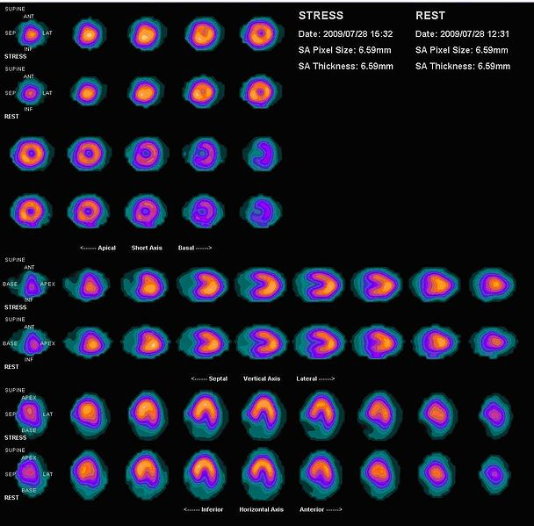
Nuclear Medicine in the U.S.
Major isotopes in modern clinical nuclear medicine:
^{99m}Tc
Diagnostic isotope for cardiac, renal, lung function, tumor imaging
Produced as fission product in thermal reactors
Costs per 10-mCi dose ranges $20-40¹
¹⁸F
PET isotope used for metabolic tumor & metastasis imaging
Produced by K-15 medical cyclotrons via ¹⁸O(p,n)¹⁸F
Costs per 5-mCi dose ranges $400-800²
¹³¹I
β-therapy isotope used for treatment of cancers, including thyroid and neuroendocrine
Produced as fission product in thermal reactors
Costs per 200-mCi dose approximately $200³
Wikimedia Commons
[1] C. Whipple and S. Larson, Medical Isotope Production Without Highly Enriched Uranium, 2009.
[2] United States Government Accountability Office and U.S. General Accounting Office, Report GAO-08-452,2008.
[3] A. N. Khalid, et al, Arch. Otolaryngol. Neck Surg., vol. 132, no. 3, pp. 244–250, 2006.

Slide 6
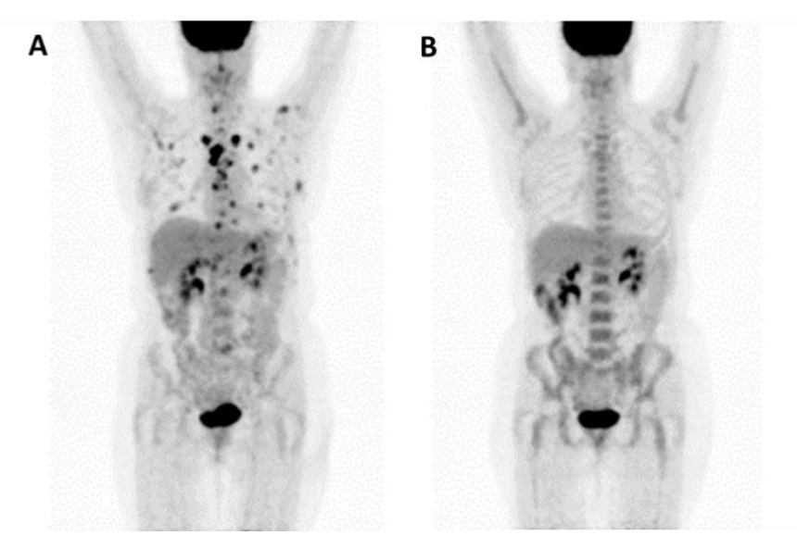
Nuclear Medicine in the U.S.
Major isotopes in modern clinical nuclear medicine:
^{99m}Tc
Diagnostic isotope for cardiac, renal, lung function, tumor imaging
Produced as fission product in thermal reactors
Costs per 10-mCi dose ranges $20-40¹
¹⁸F
PET isotope used for metabolic tumor & metastasis imaging
Produced by K~15 medical cyclotrons via ¹⁸O(p,n)¹⁸F
Costs per 5-mCi dose ranges $400-800²
¹³¹I
β-therapy isotope used for treatment of cancers, including thyroid and neuroendocrine
Produced as fission product in thermal reactors
Costs per 200-mCi dose approximately $200³
Dr. Jonathan McConathy, Washington University in St. Louis
[1] C. Whipple and S. Larson, Medical Isotope Production Without Highly Enriched Uranium, 2009.
[2] United States Government Accountability Office and U.S. General Accounting Office, Report GAO-08-452,2008.
[3] A. N. Khalid, et al, “Arch. Otolaryngol. Neck Surg., vol. 132, no. 3, pp. 244–250, 2006.
Notes:
Myocardial perfusion (cardiac stress test) scan costs ~ $900-$3000
E/A = K (Q/A)^2

Slide 7
Nuclear Medicine in the U.S.
Major isotopes in modern clinical nuclear medicine:
^{99m}Tc
Diagnostic isotope for cardiac, renal, lung function, tumor imaging
Produced as fission product in thermal reactors
Costs per 10-mCi dose ranges $20-40¹
¹⁸F
PET isotope used for metabolic tumor & metastasis imaging
Produced by K~15 medical cyclotrons via ¹⁸O(p,n)¹⁸F
Costs per 5-mCi dose ranges $400-800²
¹³¹I
β-therapy isotope used for treatment of cancers, including thyroid and neuroendocrine
Produced as fission product in thermal reactors
Costs per 200-mCi dose approximately $200³
[1] C. Whipple and S. Larson, Medical Isotope Production Without Highly Enriched Uranium, 2009.
[2] United States Government Accountability Office and U.S. General Accounting Office, Report GAO-08-452,2008.
[3] A. N. Khalid, et al, “Arch. Otolaryngol. Neck Surg., vol. 132, no. 3, pp. 244–250, 2006.

Slide 8
Nuclear Medicine in the U.S.
Established medical radioisotopes face several challenges:
Non-ideal decay properties for desired application
Extra dose
Extra range
Curtailment of production facilities (^{99m}Tc)
Thermal reactor issues
Low yield
Difficult radiochemical purification
Feasibility & deployability
Why do we keep doing this?
How can we improve this?

Slide 9
Nuclear Medicine in the U.S.
Established medical radioisotopes face several challenges:
Non-ideal decay properties for desired application
Extra dose
Extra range
Curtailment of production facilities (^{99m}Tc)
Thermal reactor issues
Low yield
Difficult radiochemical purification
Feasibility & deployability
Novel isotopes…
…and new paradigms for isotope production!
Why do we keep doing this?
How can we improve this?

Slide 10
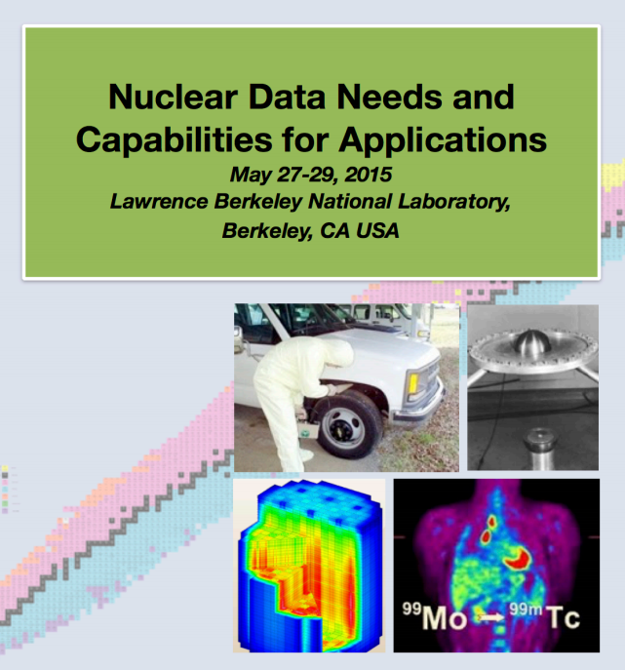
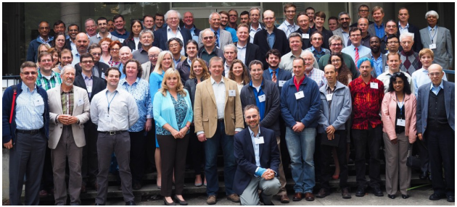
Some perspective
Notes:
Dr Qaim - plenary speaker and instigator of priority isotopes

Slide 11
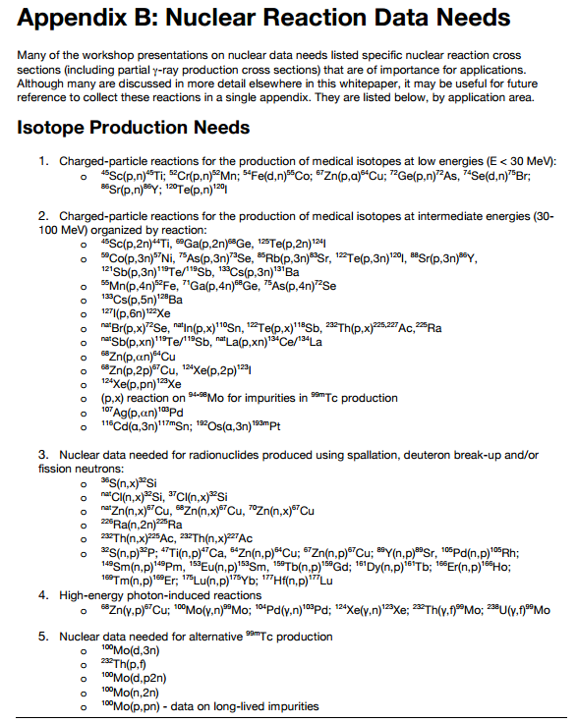
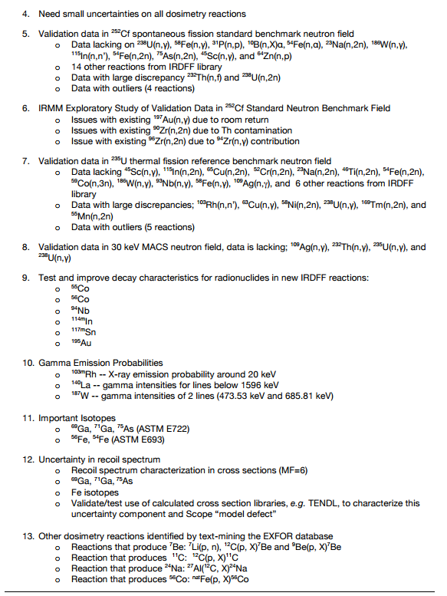
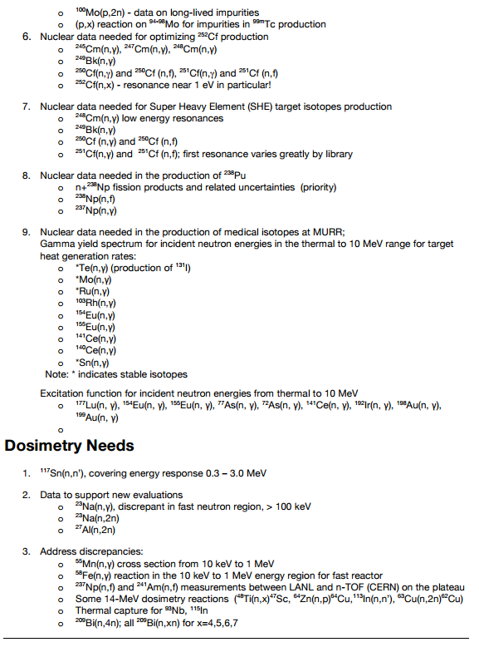
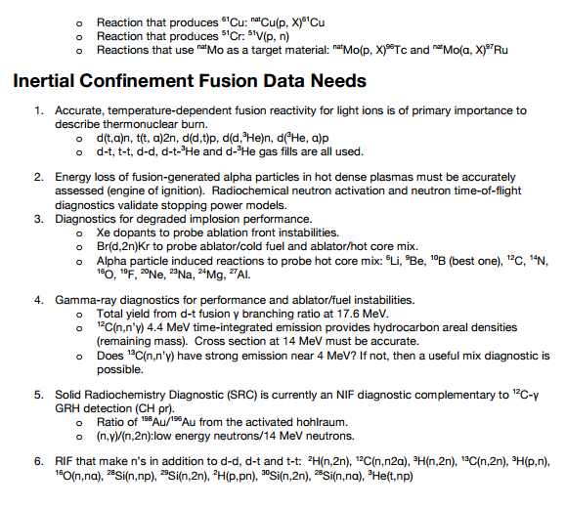
Some perspective
Highlight from WTTC 2016: ⁵⁴Fe(p,α)⁵¹Mn
NDNCA Whitepaper available at http://bang.berkeley.edu/events/ndnca/whitepaper/

Slide 12

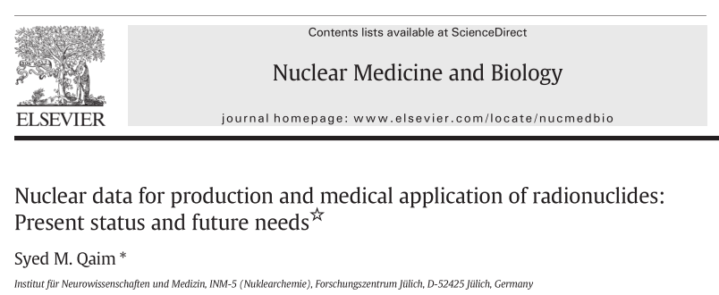
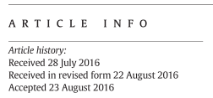
Some perspective

Slide 13
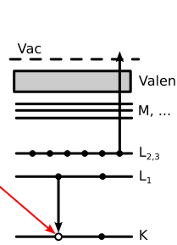
Some perspective
Emerging trends for next-generation (targeted & personalized) nuclear medicine:
Targeted alpha therapy (5-10 MeV)
40-80 μm range → single cell
Targeted Auger therapy (20 eV – 1 keV)
1 nm – 2 μm → cellular nucleus
Theranostic medicine
Simultaneous imaging and therapy

Slide 14
Overview
Ongoing targeted experimental campaign to address these needs:
(n,p) production cross sections – UCB
Stacked-target charged particle excitation functions
Low energy – LBNL
Moderate energy – LANL
Bonus – spin distribution of excited nuclear states

Slide 15
Theory
___________________________

Slide 16
⁶⁴Cu and ⁴⁷Sc (n,p) Cross-Section Measurements
___________________________

Slide 17
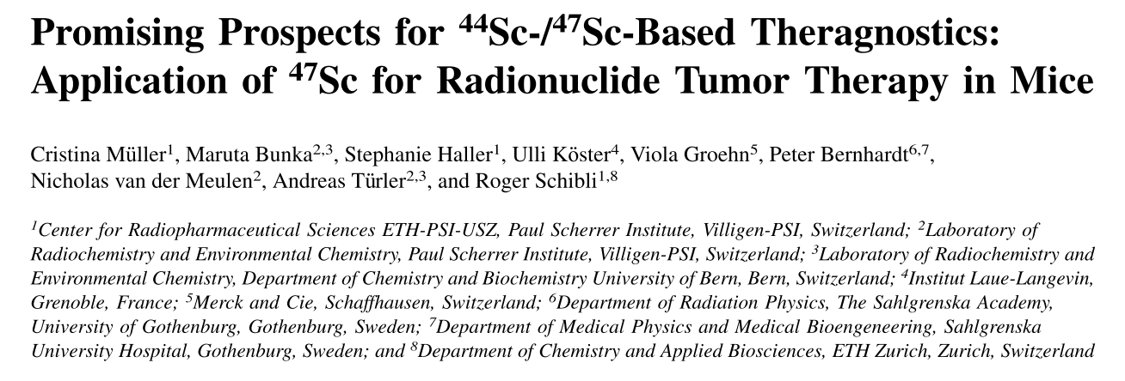
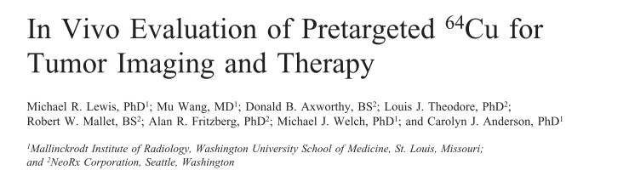
Medical Applications
Emerging medical radionuclides
⁶⁴Cu (t_{1/2} = 12.7 hr) – 61% β⁺ to ⁶⁴Ni, 39% β⁻ to ⁶⁴Zn
⁴⁷Sc (t_{1/2} = 3.35 d) – β⁻ to ⁴⁷Ti, with 159-keV γ

Slide 18
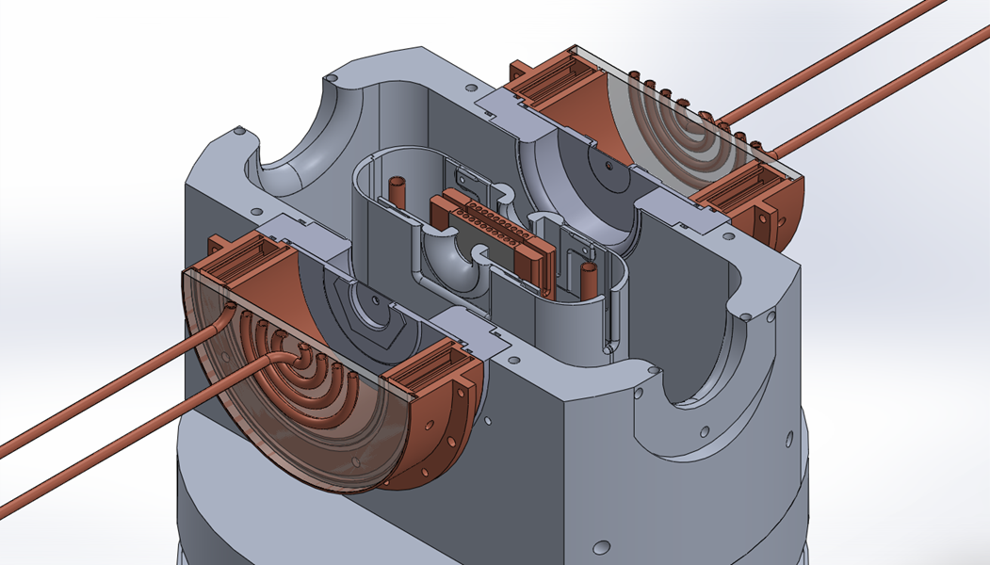
The UC Berkeley High Flux Neutron Generator
2.45 MeV neutrons, 10⁷ n/s/cm²
Extraction Plate: 5mm diameter
D Plasma
100kV
RF
DD Fusion
D beam
1-1000mA
Deuterium Gas
H₂O

Slide 19
Why (n,p) via DD neutrons?
Advantages over thermal reactors:
Co-production of many unwanted activities via (n,γ)
Far cheaper startup costs, no proliferation concerns
Advantages over DT neutrons:
14-15 MeV DT neutrons open up unwanted (n,pxn) channels, contaminating the desired product
No tritium handling concerns
2-3 MeV DD neutrons are ideal for (n,p) and (n,α) production, but often suffer from fairly low flux, and poor nuclear data

Slide 20
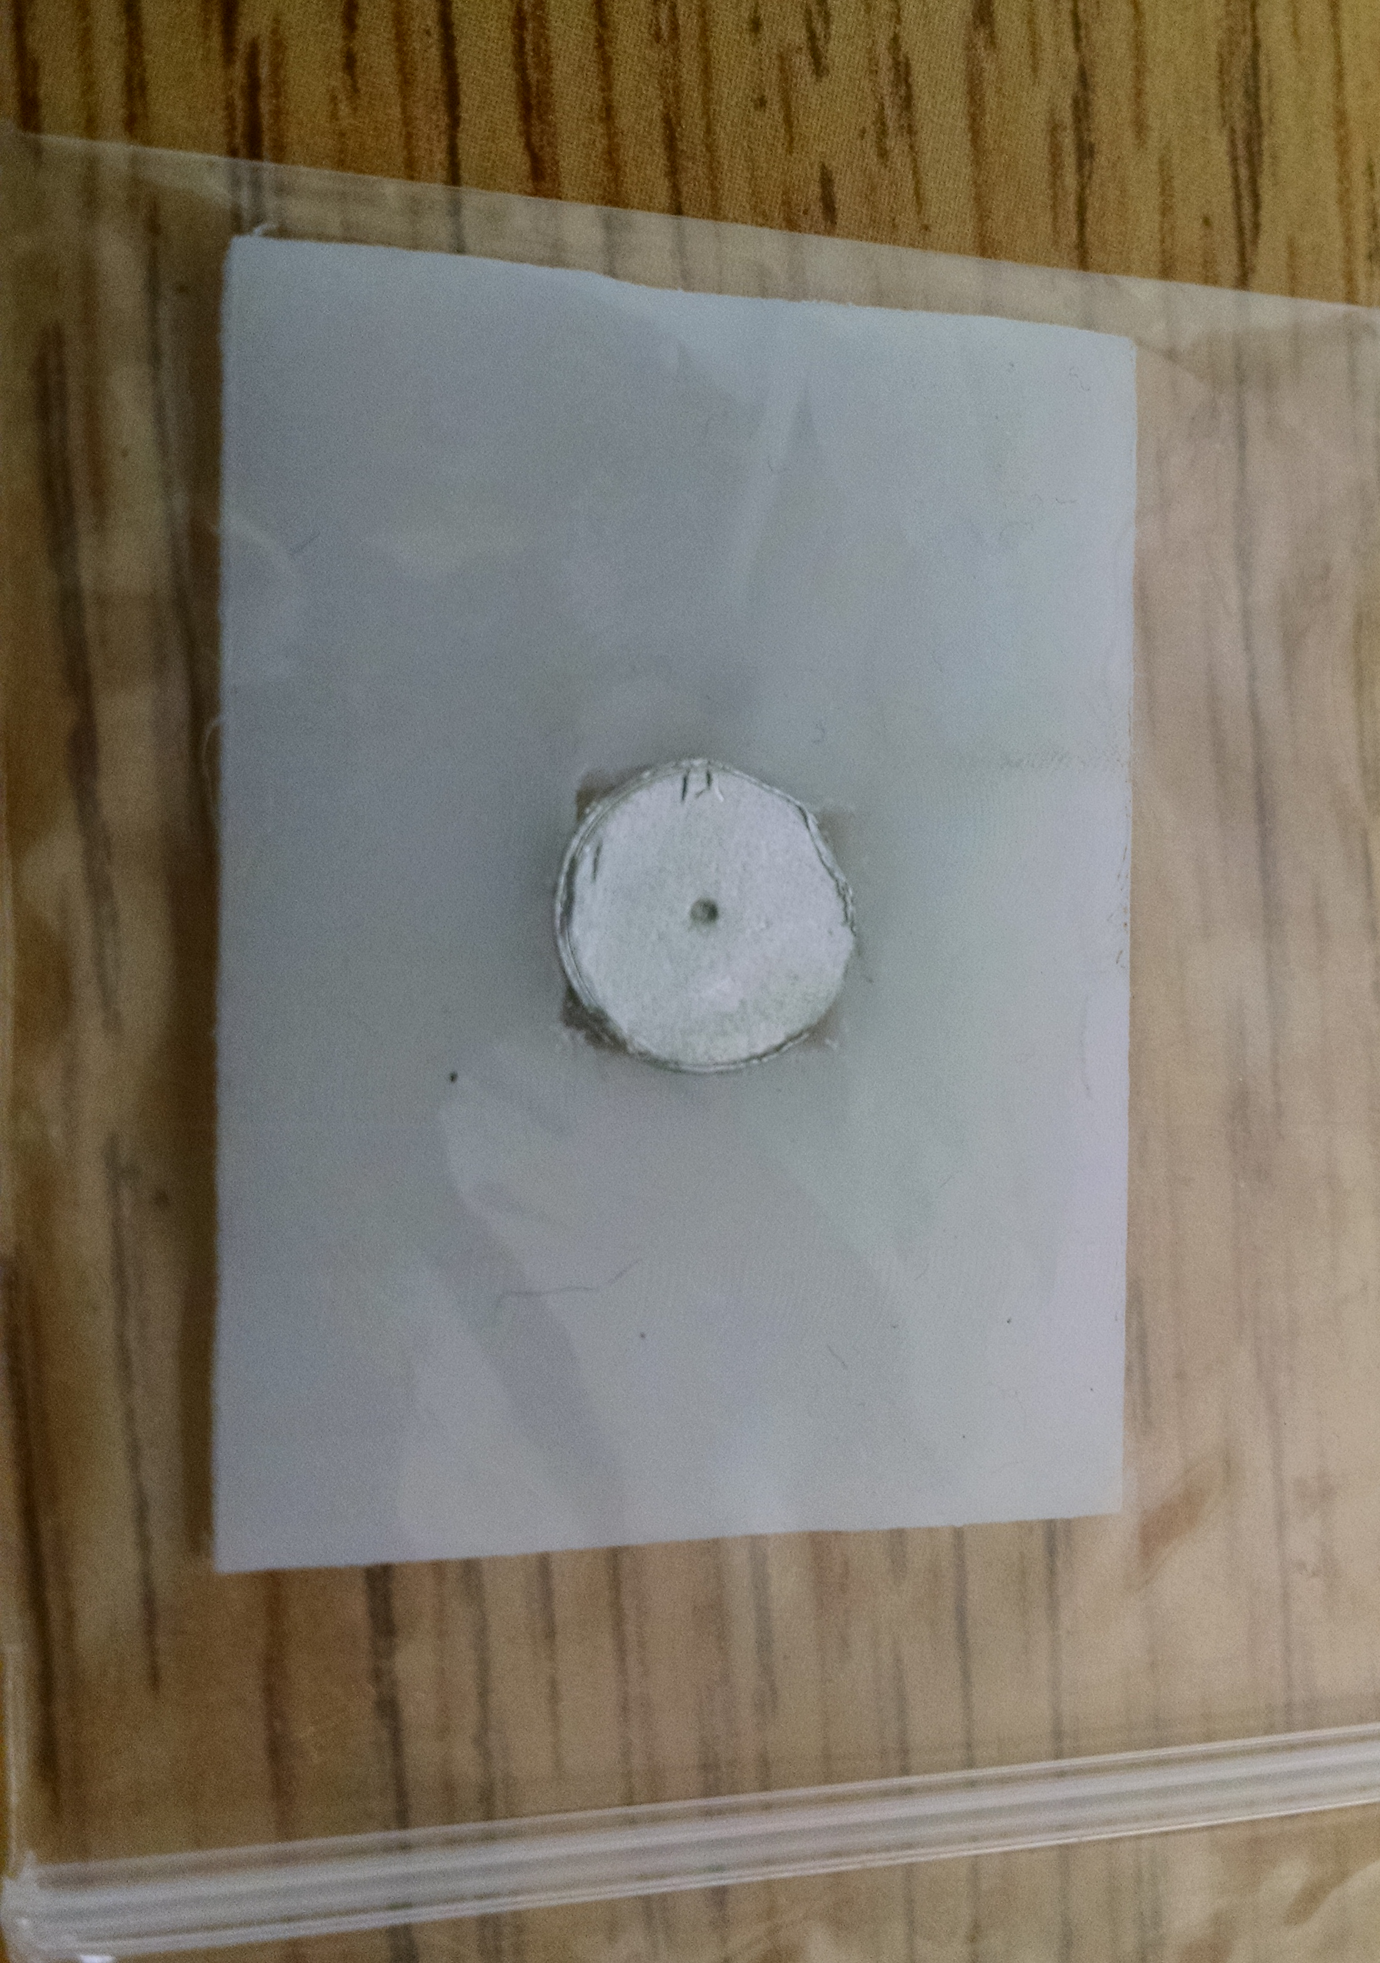
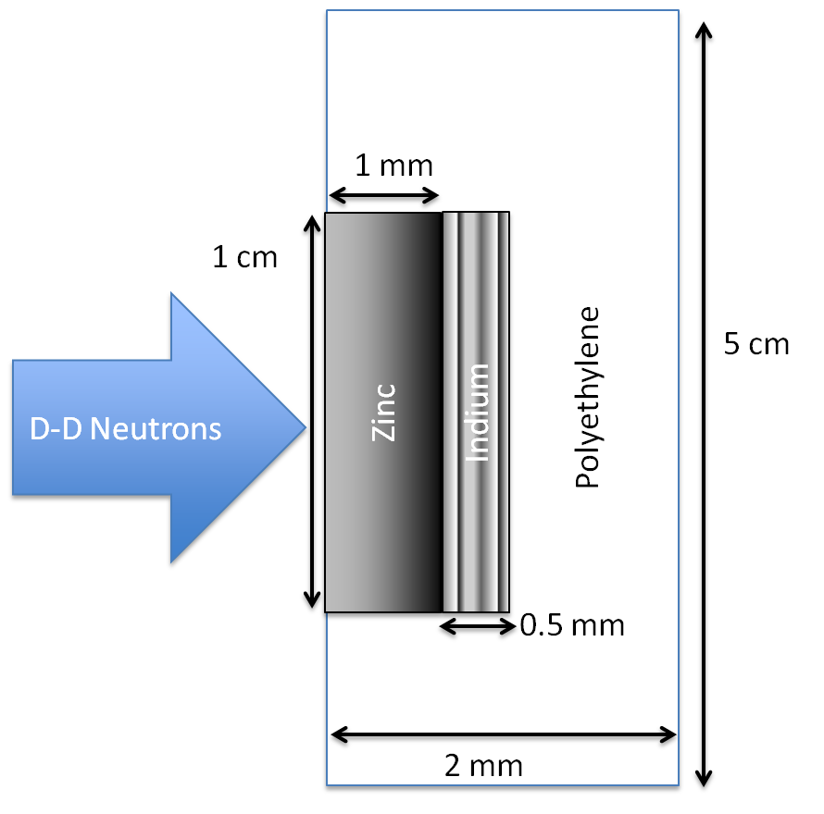
The UC Berkeley High Flux Neutron Generator
Dosimetry: IRDFF ^{113/115}In(n,n’)^{113m/115m}In standards
Foils Used | Metal Purity | Abundance (a/o) | Foil Density (mg/cm²)
^{nat}In | > 99.999% | ¹¹³In (4.29%), ¹¹⁵In (95.71%) | 365.5
^{nat}Zn | > 99.99% | ⁶⁴Zn (49.17%) | 714.1
^{nat}Ti | 99.999% | ⁴⁷Ti (7.44%) | 450.6
Notes:
64Zn - 49.17%, 66Zn – 27.73%, 67Zn – 4.04%, 68Zn – 18.45%
46Ti – 8.25%, 47Ti – 7.44%, 48Ti – 73.72%, 49Ti – 5.41%, 50Ti – 5.18%

Slide 21
The UC Berkeley High Flux Neutron Generator
Zn
Zn
In
In

Slide 22
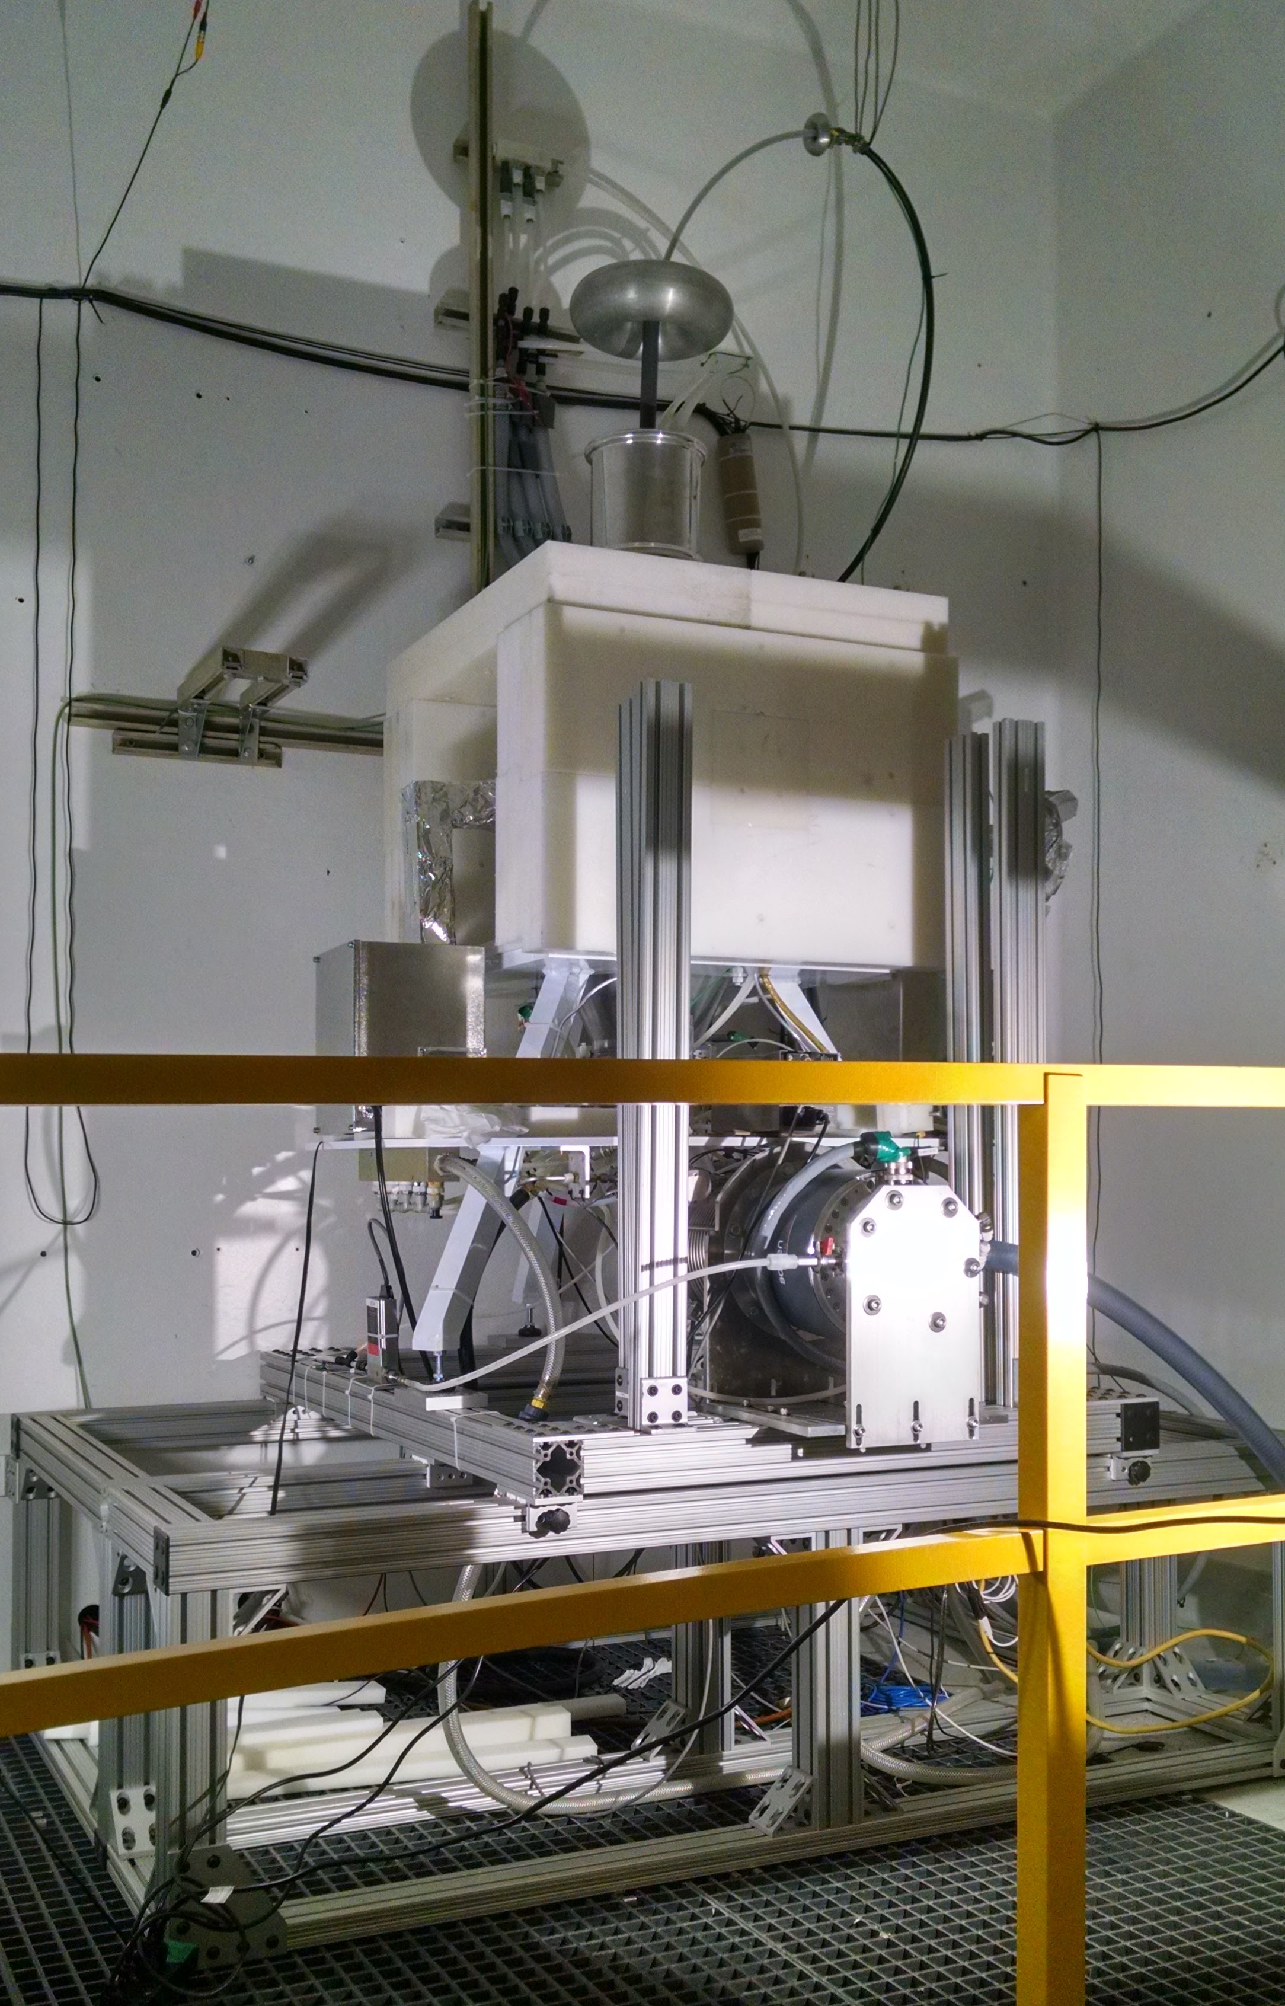
The UC Berkeley High Flux Neutron Generator
Zn
In

Slide 23
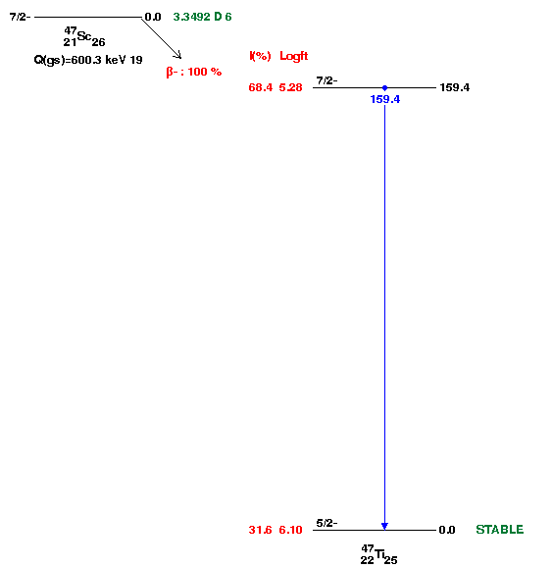
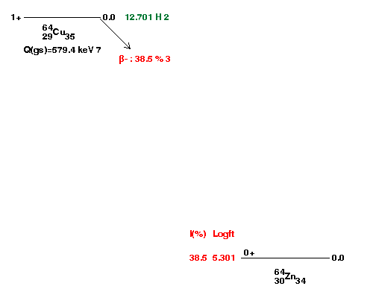
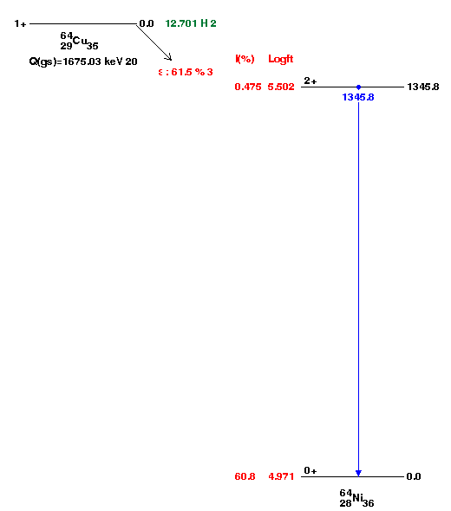
Relative Activation Measurements

Slide 24
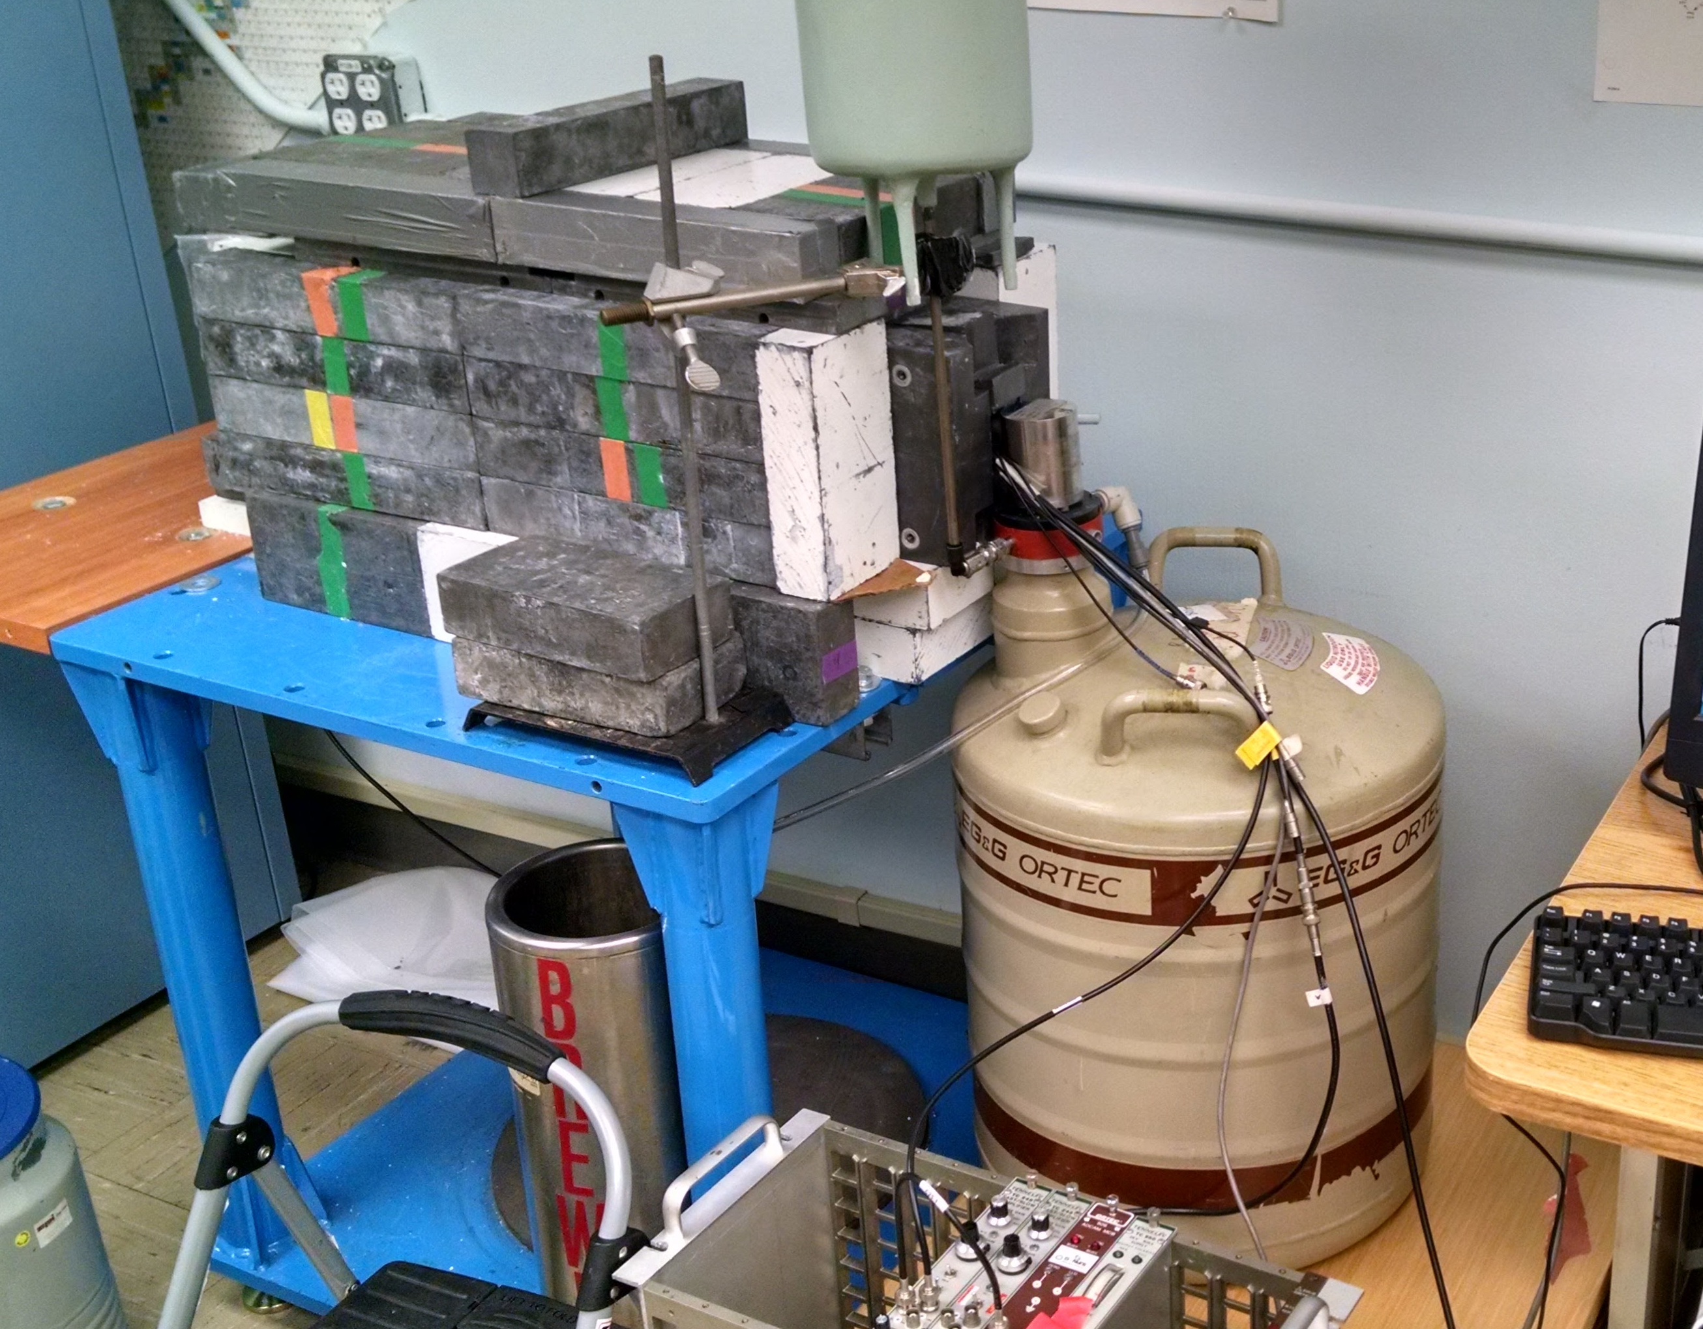
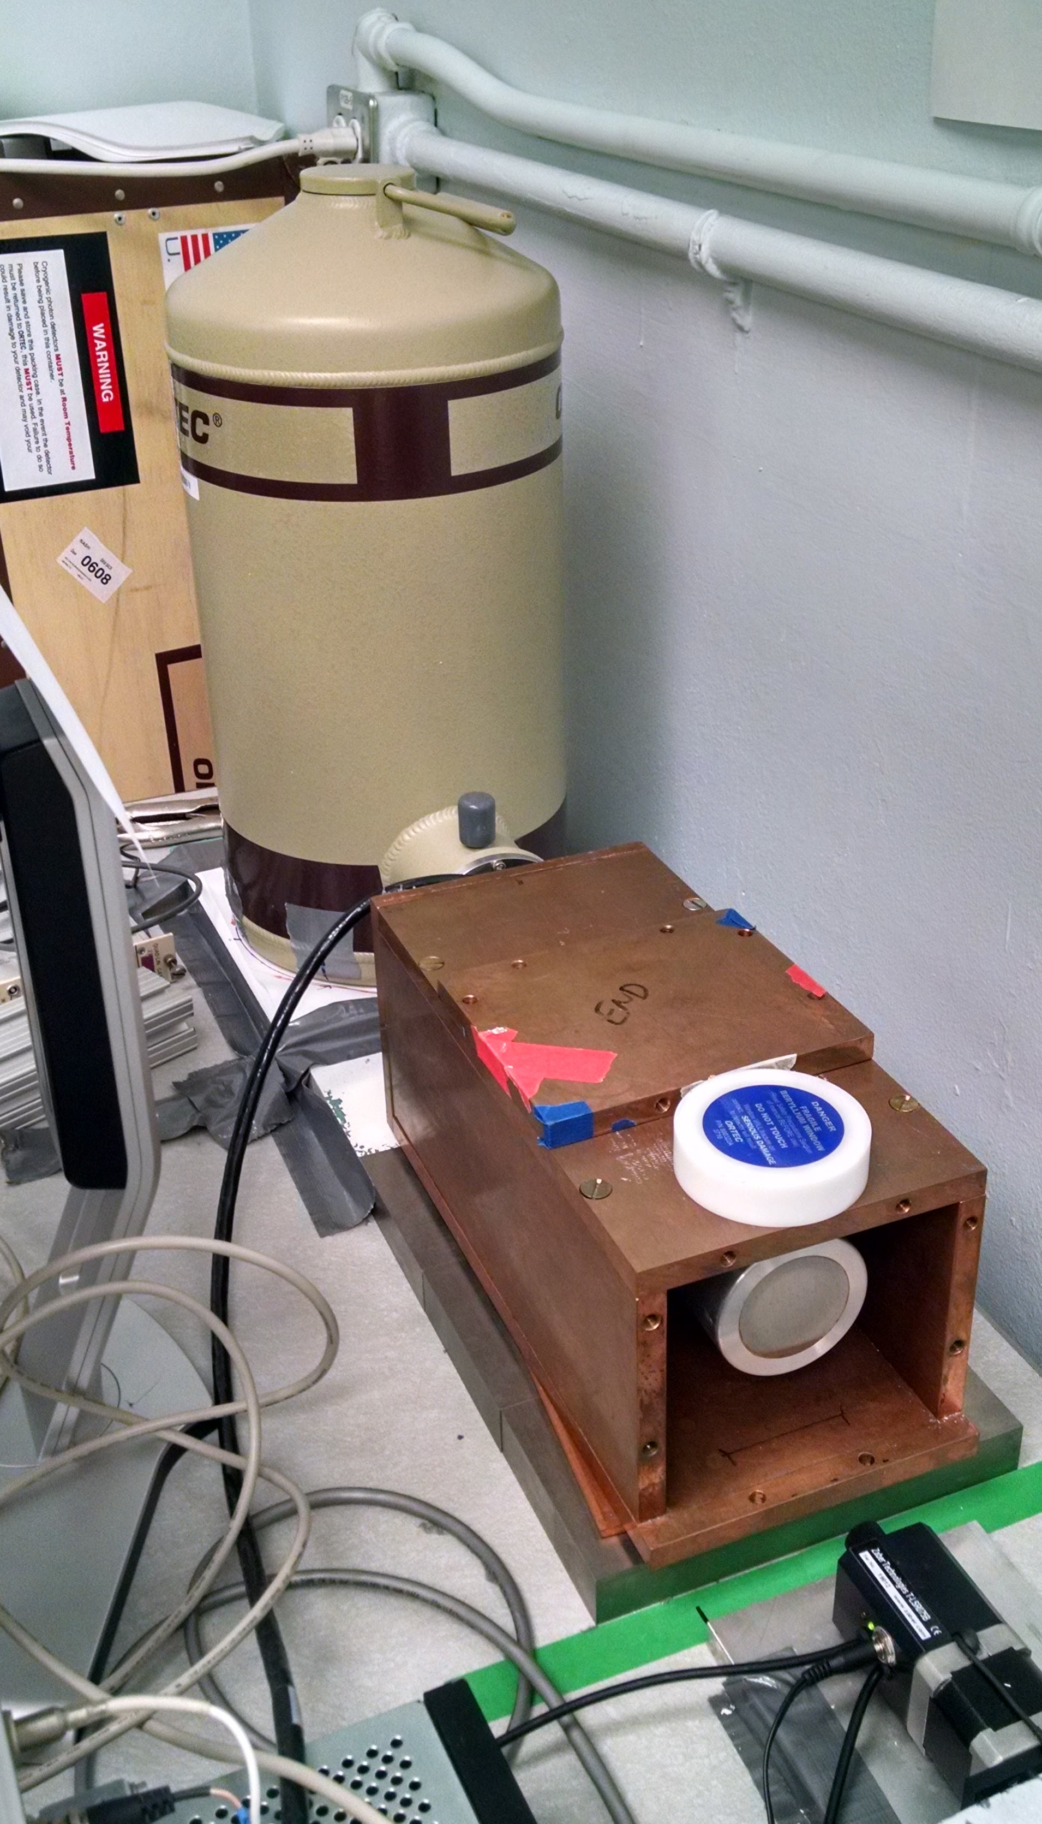
Relative Activation Measurements
Ortec Planar LEPS detector
Ortec 80% HPGe detector

Slide 25
Relative Activation Measurements

Slide 26
Relative Activation Measurements
t_{1/2} = 4.519 ± 0.016 h
(Accepted = 4.486 h)
χ² /ν = 1.653
t_{1/2} = 12.10 ± 0.85 h
(Accepted = 12.701 h)
χ² /ν = 1.743
Notes:
Producing O(10 kBq), with dead time < 5%

Slide 27
Relative Activation Measurements
What’s going on???

Slide 28
Neutron Energy Spread
n
n
θ
n
Titanium
d
D
n

Slide 29
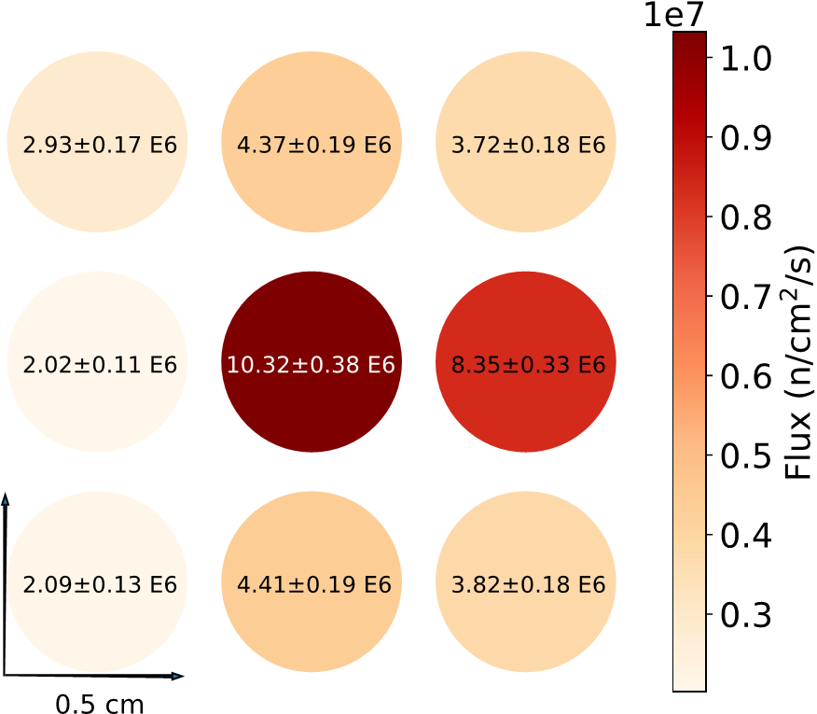
Neutron Energy Spread
Neutron Energy Spread
Relative fluxes as seen by a 3 x 3 array of 0.5-cm diameter indium foils. The central foil corresponds to the location in which target and monitor
foils were mounted during the cross section measurements, verifying
that the beam is centered on the middle of mounted foils

Slide 30
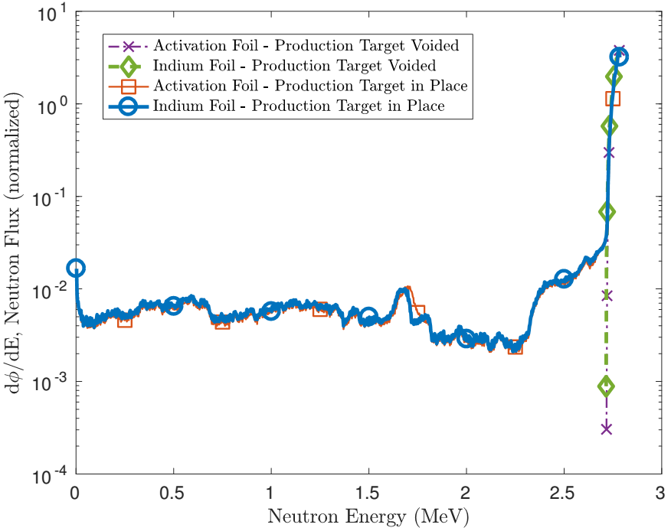
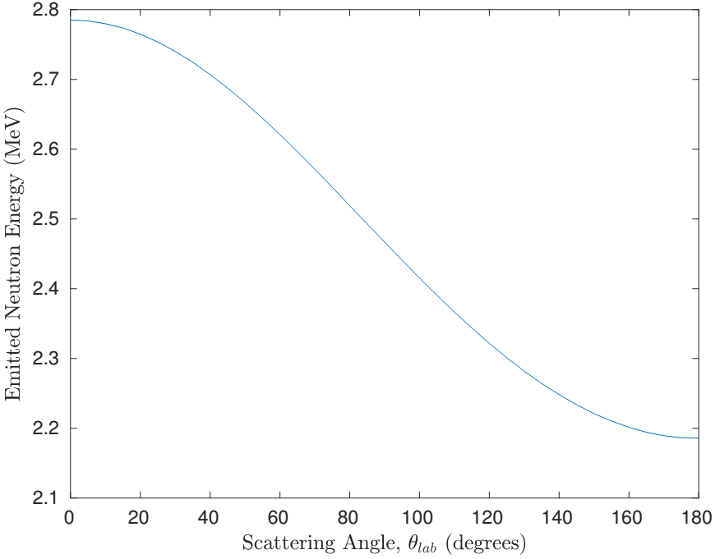
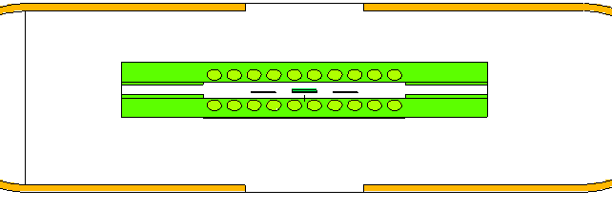
Neutron Energy Spread
Neutron Energy Spread
H. Liskien et al., Nucl Data Tables, vol 11, 2973
Neutron flux profile modeled in target and monitor foil, using MCNP6

Slide 31
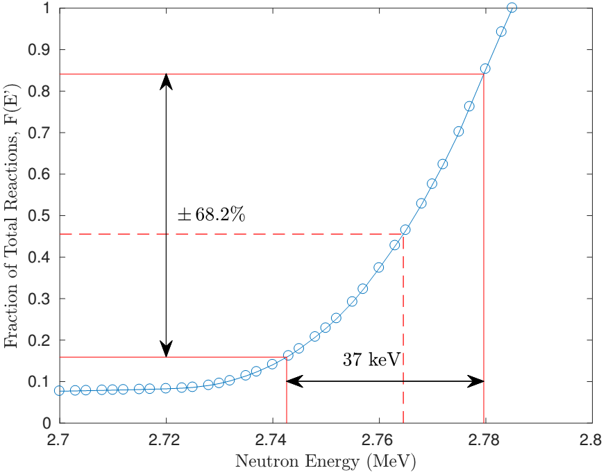
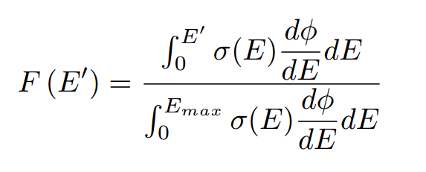
Neutron Energy Spread
Neutron Energy Spread
H. Liskien et al., Nucl Data Tables, vol 11, 2973
Neutron flux profile modeled in target and monitor foil, using MCNP6
-σ_{<E>}
+σ_{<E>}
<E>
E_{max} = Maximum energy neutron subtended by foil
F(E’) = Fraction of Total Reactions induced up to energy E’

Slide 32
Neutron Energy Spread
⁶⁴Zn(n,p)⁶⁴Cu
Before…
⁴⁷Ti(n,p)⁴⁷Sc

Slide 33
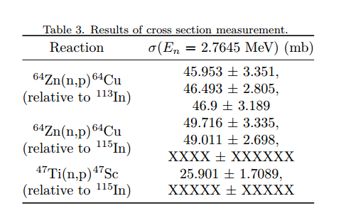
Neutron Energy Spread
⁶⁴Zn(n,p)⁶⁴Cu
After!
⁴⁷Ti(n,p)⁴⁷Sc

Slide 34
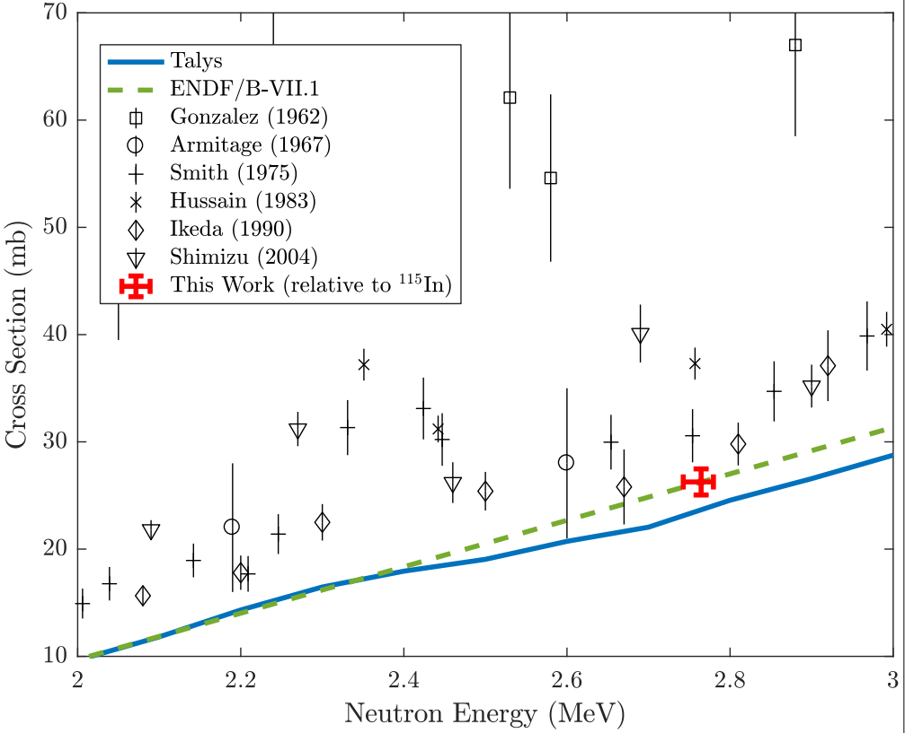
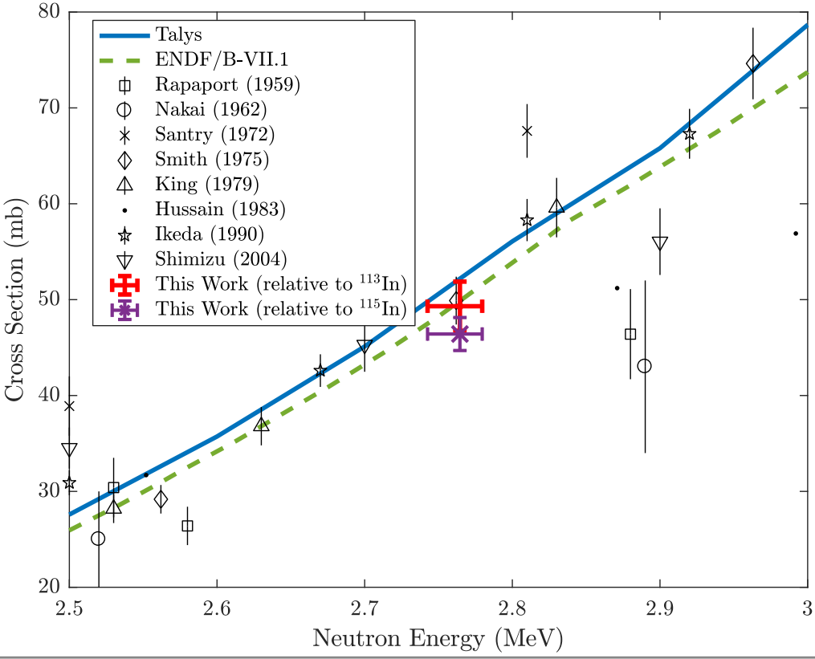
Neutron Energy Spread
⁶⁴Zn(n,p)⁶⁴Cu
After!
⁴⁷Ti(n,p)⁴⁷Sc
⁴⁷Ti(n,p)⁴⁷Sc

Slide 35
Neutron Energy Systematics
Indium foils also undergo ¹¹⁵In(n, γ)¹¹⁶In, which emits a 417 keV γ following β⁻ decay
Capture is strongly subject to thermal neutron contamination, as the (n, γ) cross section at 25 meV is ~ 2000x that at 2.7 MeV
MCNP neutron energy spectrum estimates thermal & epithermal neutrons comprise 0.0771% of all neutrons
Confirmed experimentally - production of ¹¹⁶In was consistent with an effective neutron energy of 2.45 MeV
Activation consistent with predominantly fast neutron capture confirms paucity of “room return” thermal neutrons
Highlights the possibility of using HFNG-like designs for (n,p) isotope production free from (n, γ) contamination products!

Slide 36
Neutron Energy Systematics
Use of Indium activation to assign the effective energy window for activation foils introduces a small systematic uncertainty, as the two have differing reaction threshold energies
Convolution of IRDFF In(n,n’) cross sections with our MCNP neutron flux profile predicts that the total activity in the In produced by the low energy neutrons (below the “knee” near 2.25 MeV is 2.17%.
If we trust the (n,p) excitation functions for Zn and Ti from TALYS, the corresponding values from TALYS for the Cu and Sc activity are 0.24% and 0.85%, respectively.
If we assume an uncertainty of ±50% in the TALYS calculations in this energy region, this would lead to a shift in (n,p) cross sections for the Cu and Sc activities of 0.12% and 0.42%, respectively.

Slide 37
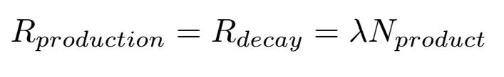
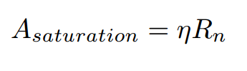
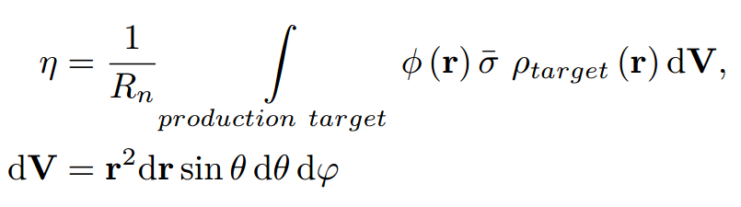
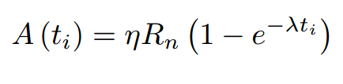
Neutron Utilization

Slide 38
Neutron Utilization
Theoretical saturation activities are currently estimated at 1.5 kBq of ⁶⁴Cu, 0.11 kBq of ⁴⁷Sc
Measured production rates were 453.8 Bq of ⁶⁴Cu, 31.6 Bq of ⁴⁷Sc
Implies η ≈ 3 x 10⁻⁵ (⁶⁴Cu), η ≈ 1 x 10⁻⁵ (⁴⁷Sc)

Slide 39
Stacked-target Charged Particle Excitation Functions
___________________________
^{Low Energy – LBNL}

Slide 40
Why charged particle production?
Cyclotron
Many hospitals have small K~15 medical cyclotrons for PET tracer production
Leverage existing infrastructure
Explore higher energies for regional research cyclotrons, basic science
Linac
Commonly used for high-energy production (LANL – IPF)
Useful for anchoring to complementary low-energy measurements

Slide 41
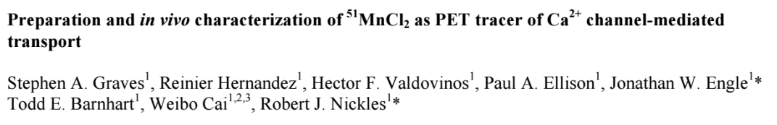
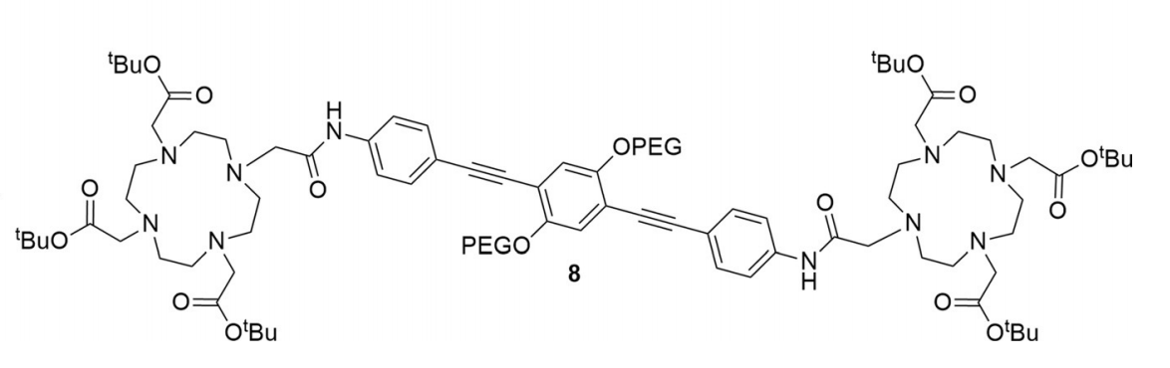
^{51,52}Mn - Motivation
Emerging medical radionuclides
⁵¹Mn (t_{1/2} = 46 min, 97% β⁺) – short-lived PET tracer for metabolic studies
^{52g}Mn (t_{1/2} = 5.6 d, 29% β⁺) – long-lived PET tracer for neuron tracking, immune studies
Manganese has well-established biochemistry and uptake via DOTA-based chelation
Almost no Fe(p,x) XS measurements exist – can use these to probe spin physics in the A≈50 region
Mn
Mn
Notes:
The four secondary amine groups are modified by replacement of the N-H centers with N-CH₂CO₂H groups. The resulting aminopolycarboxylic acid, upon ionization of the carboxylic acid groups, is a high affinity chelating agent for di- and trivalent cations.

Slide 42
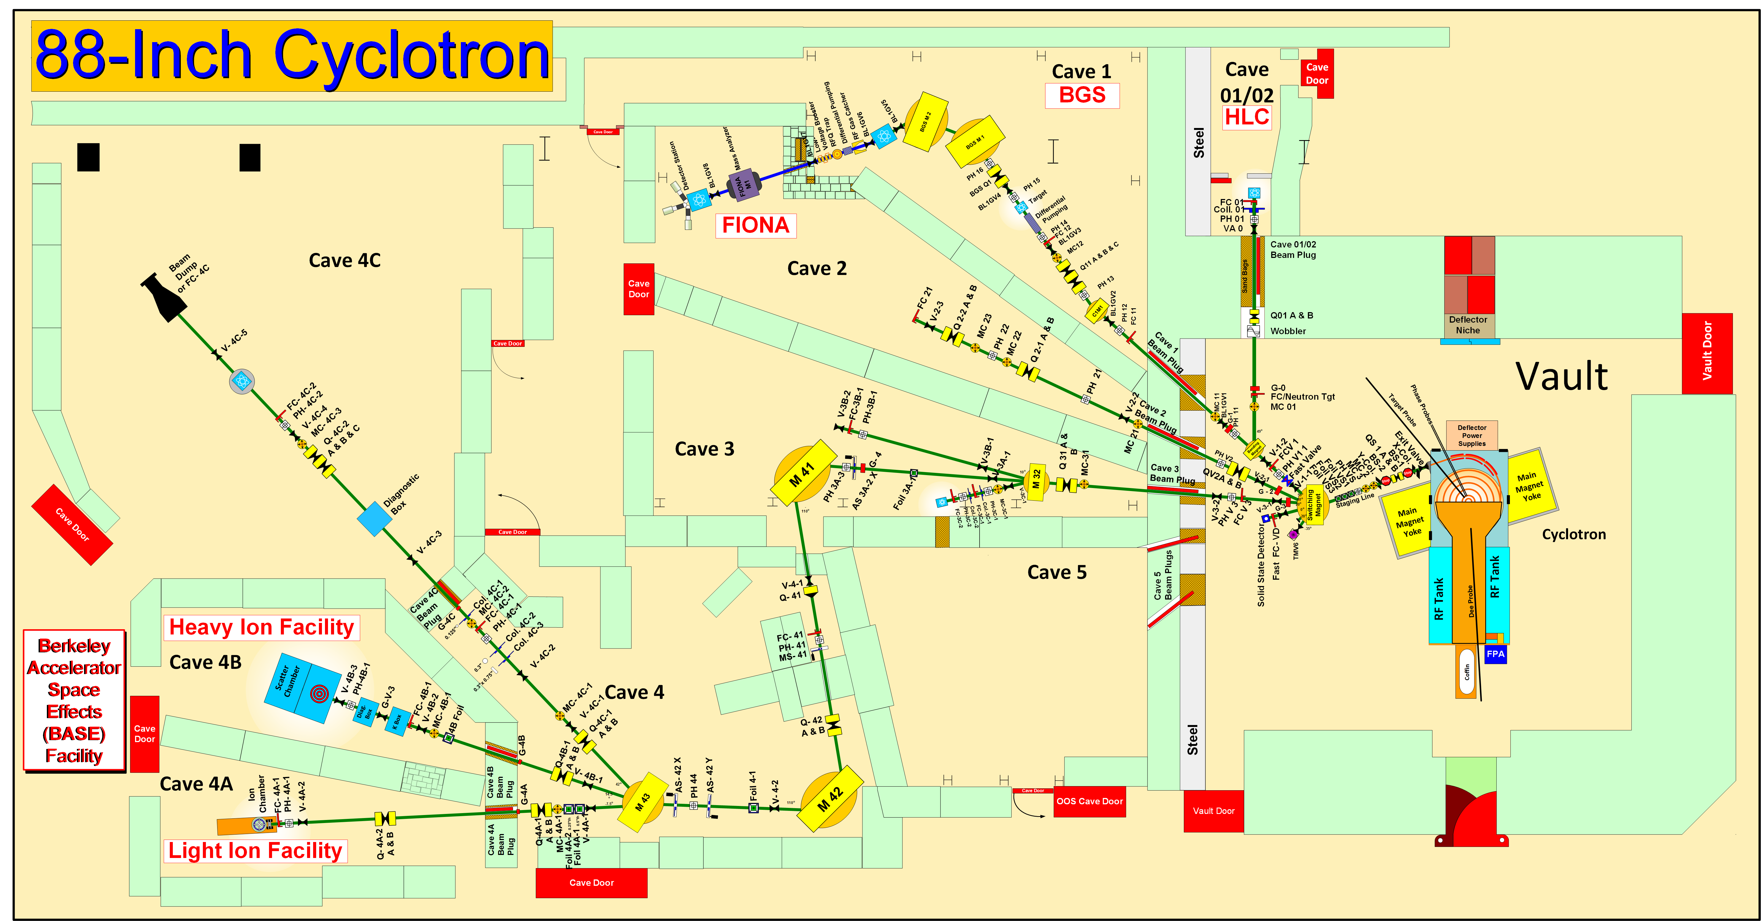
Methodology
K-140
Notes:
Cyclotron freq w = Q B / m
T = (m/2) w^2 r^2
T/A = (B r / 2 m)^2 (Q/A)^2 = K (Q/A)^2

Slide 43
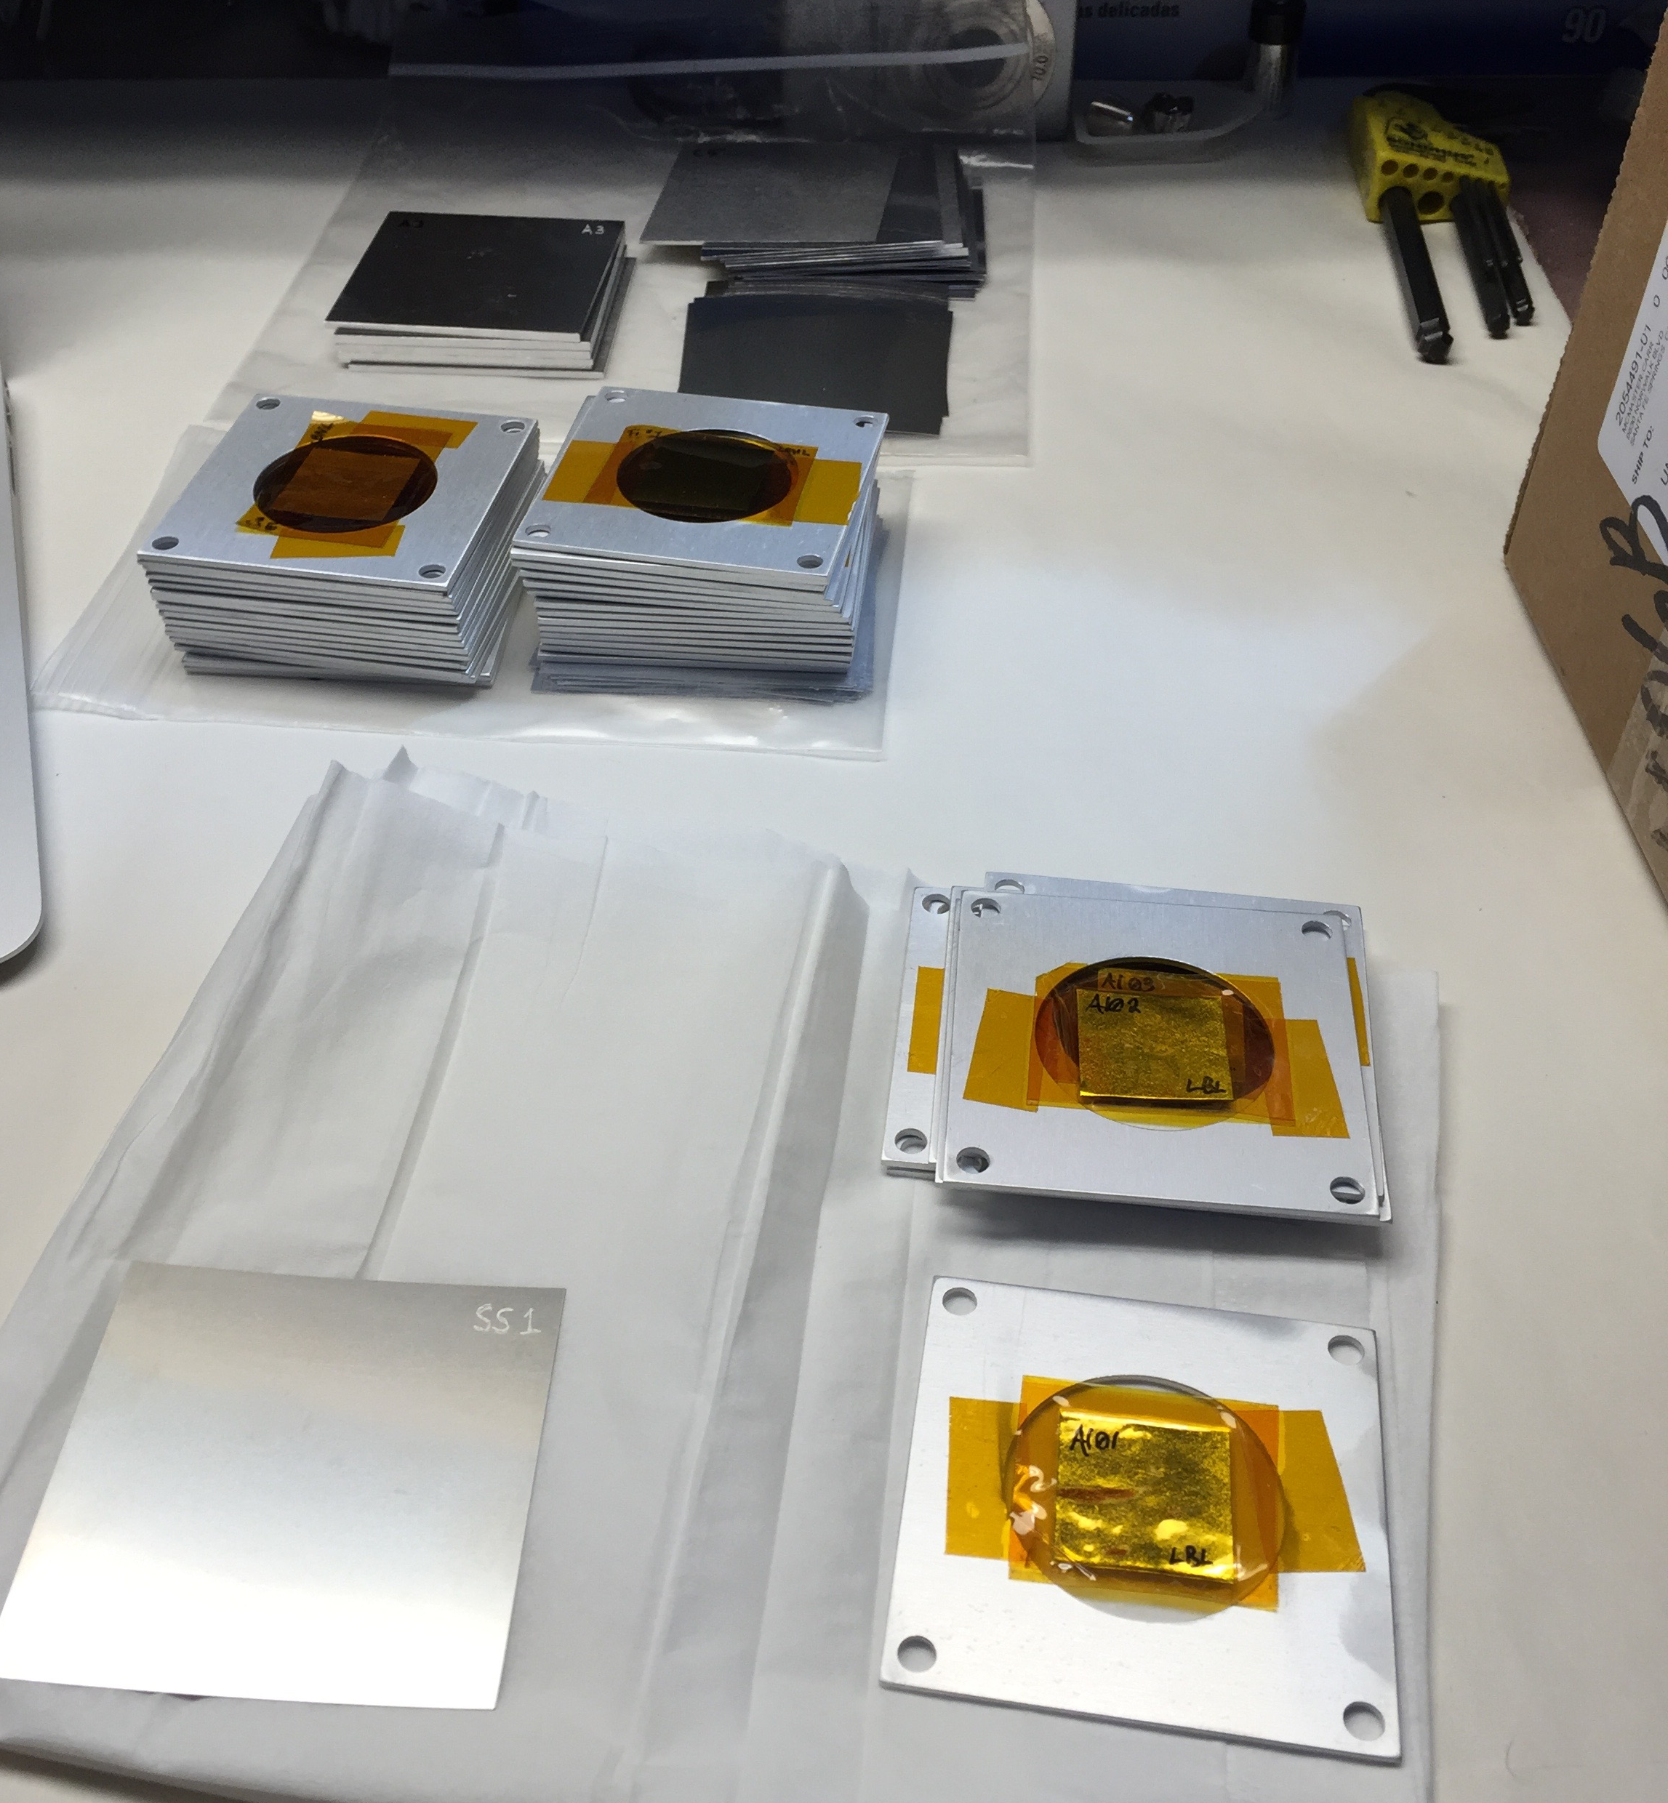
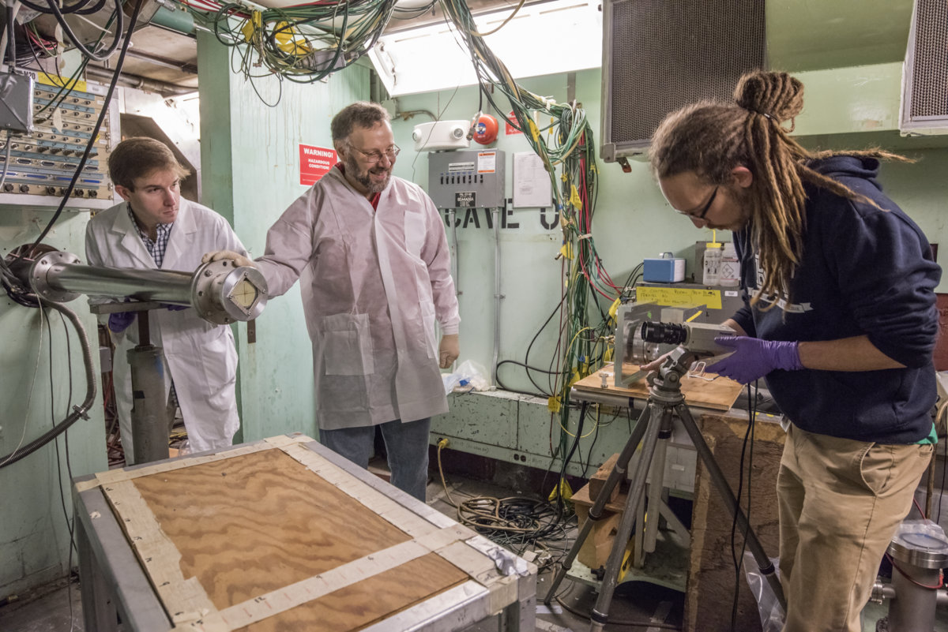
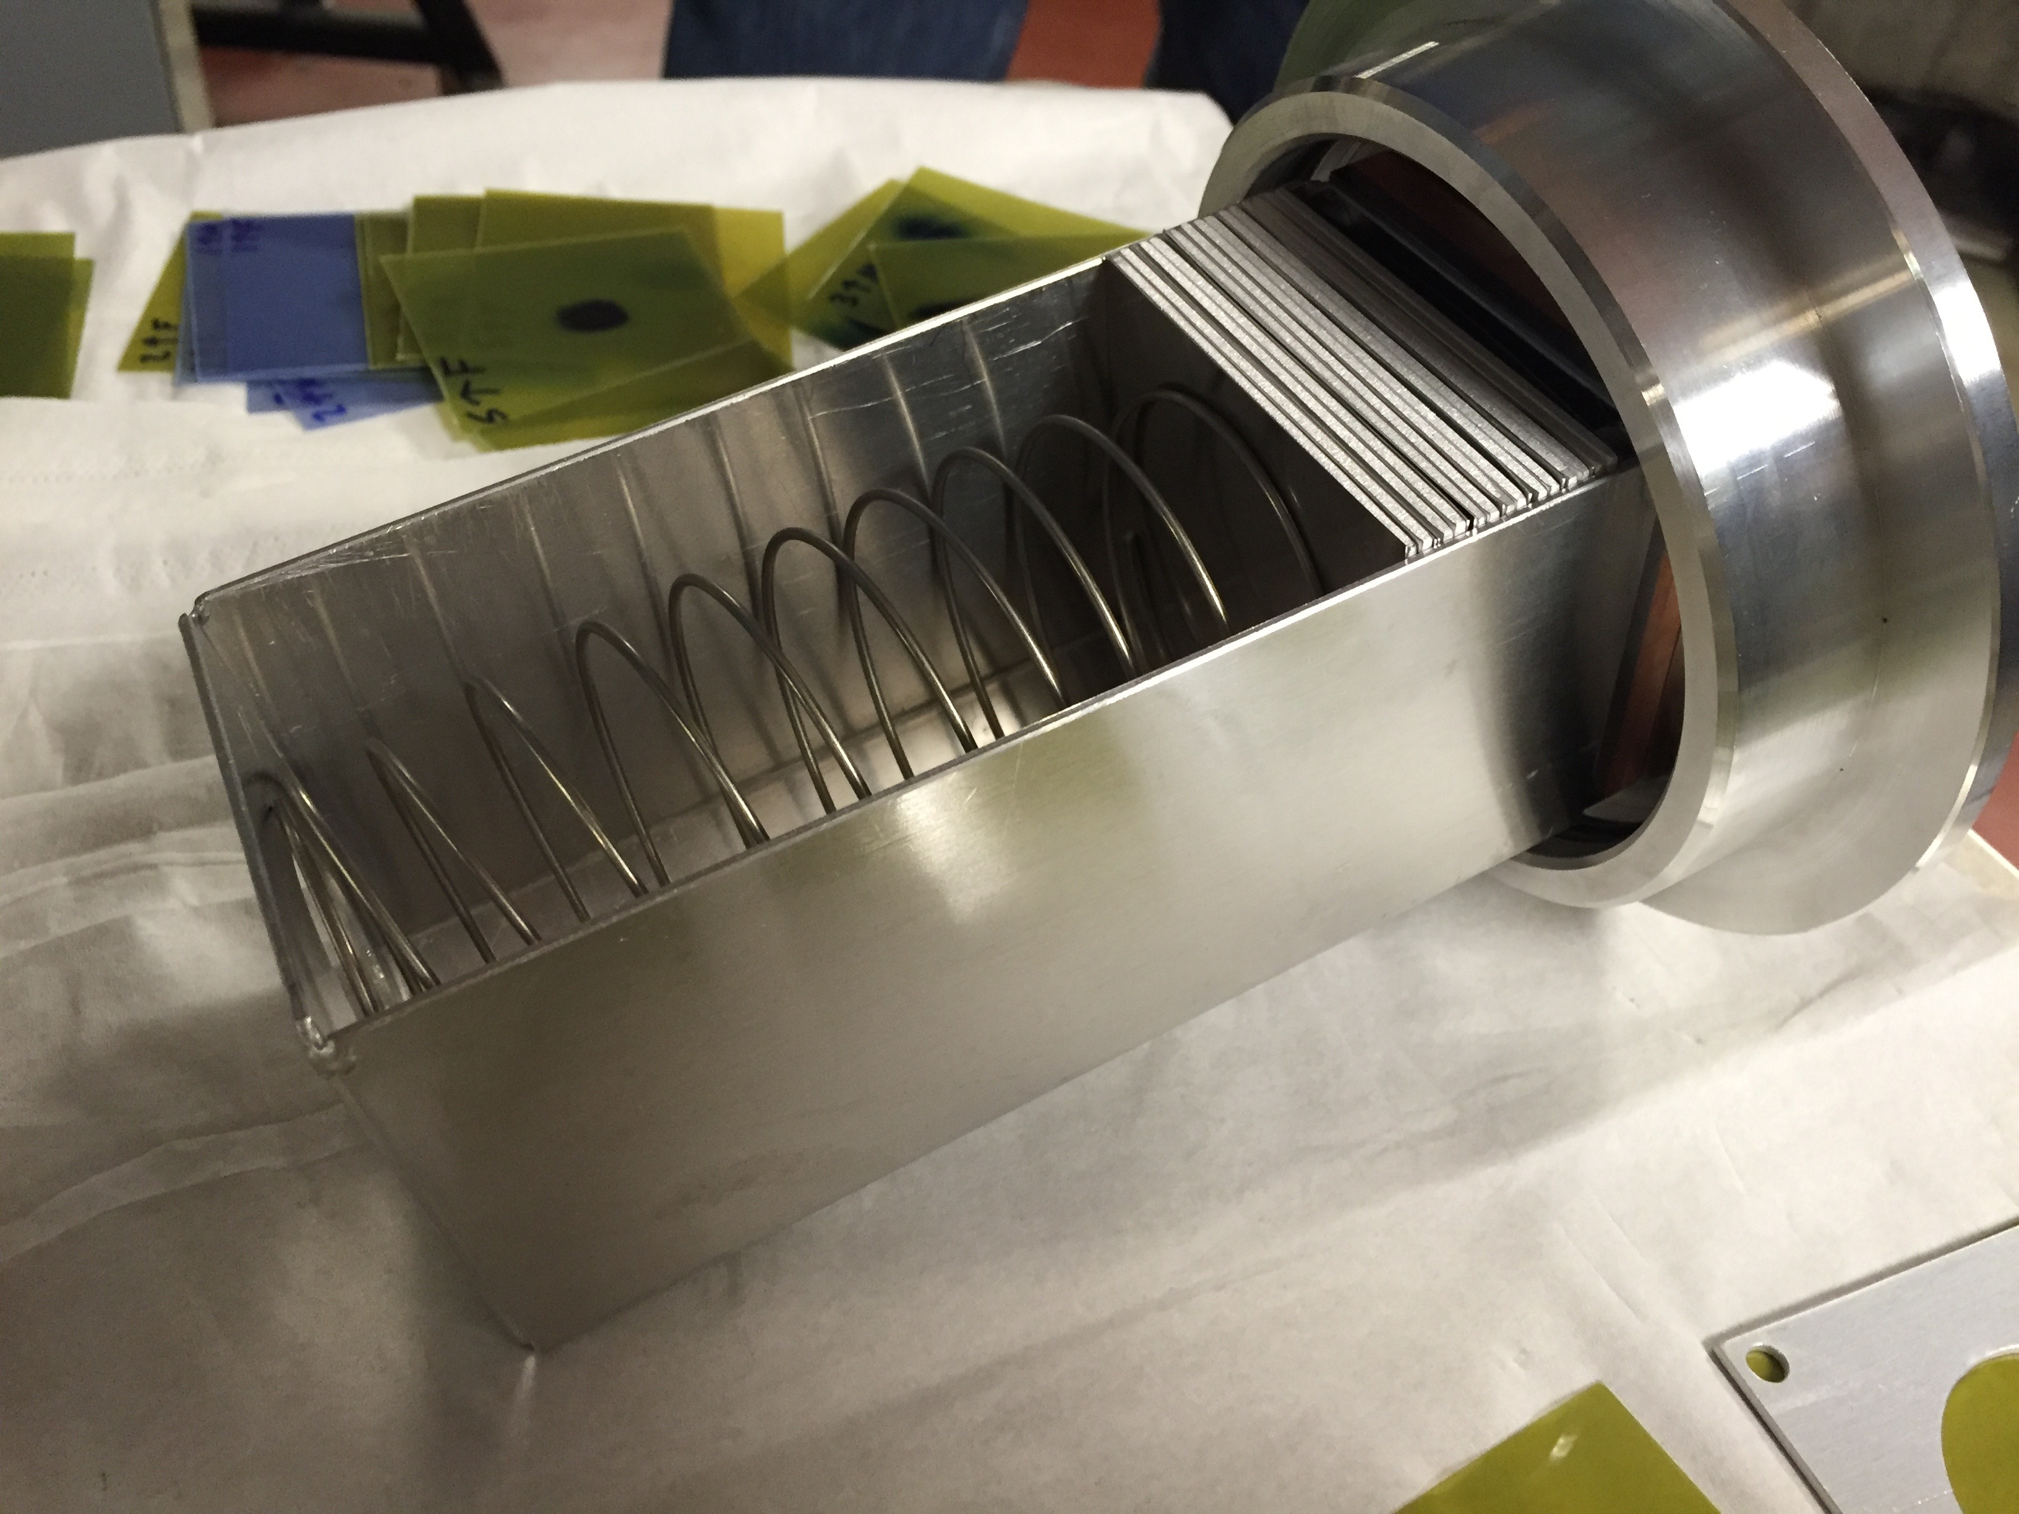
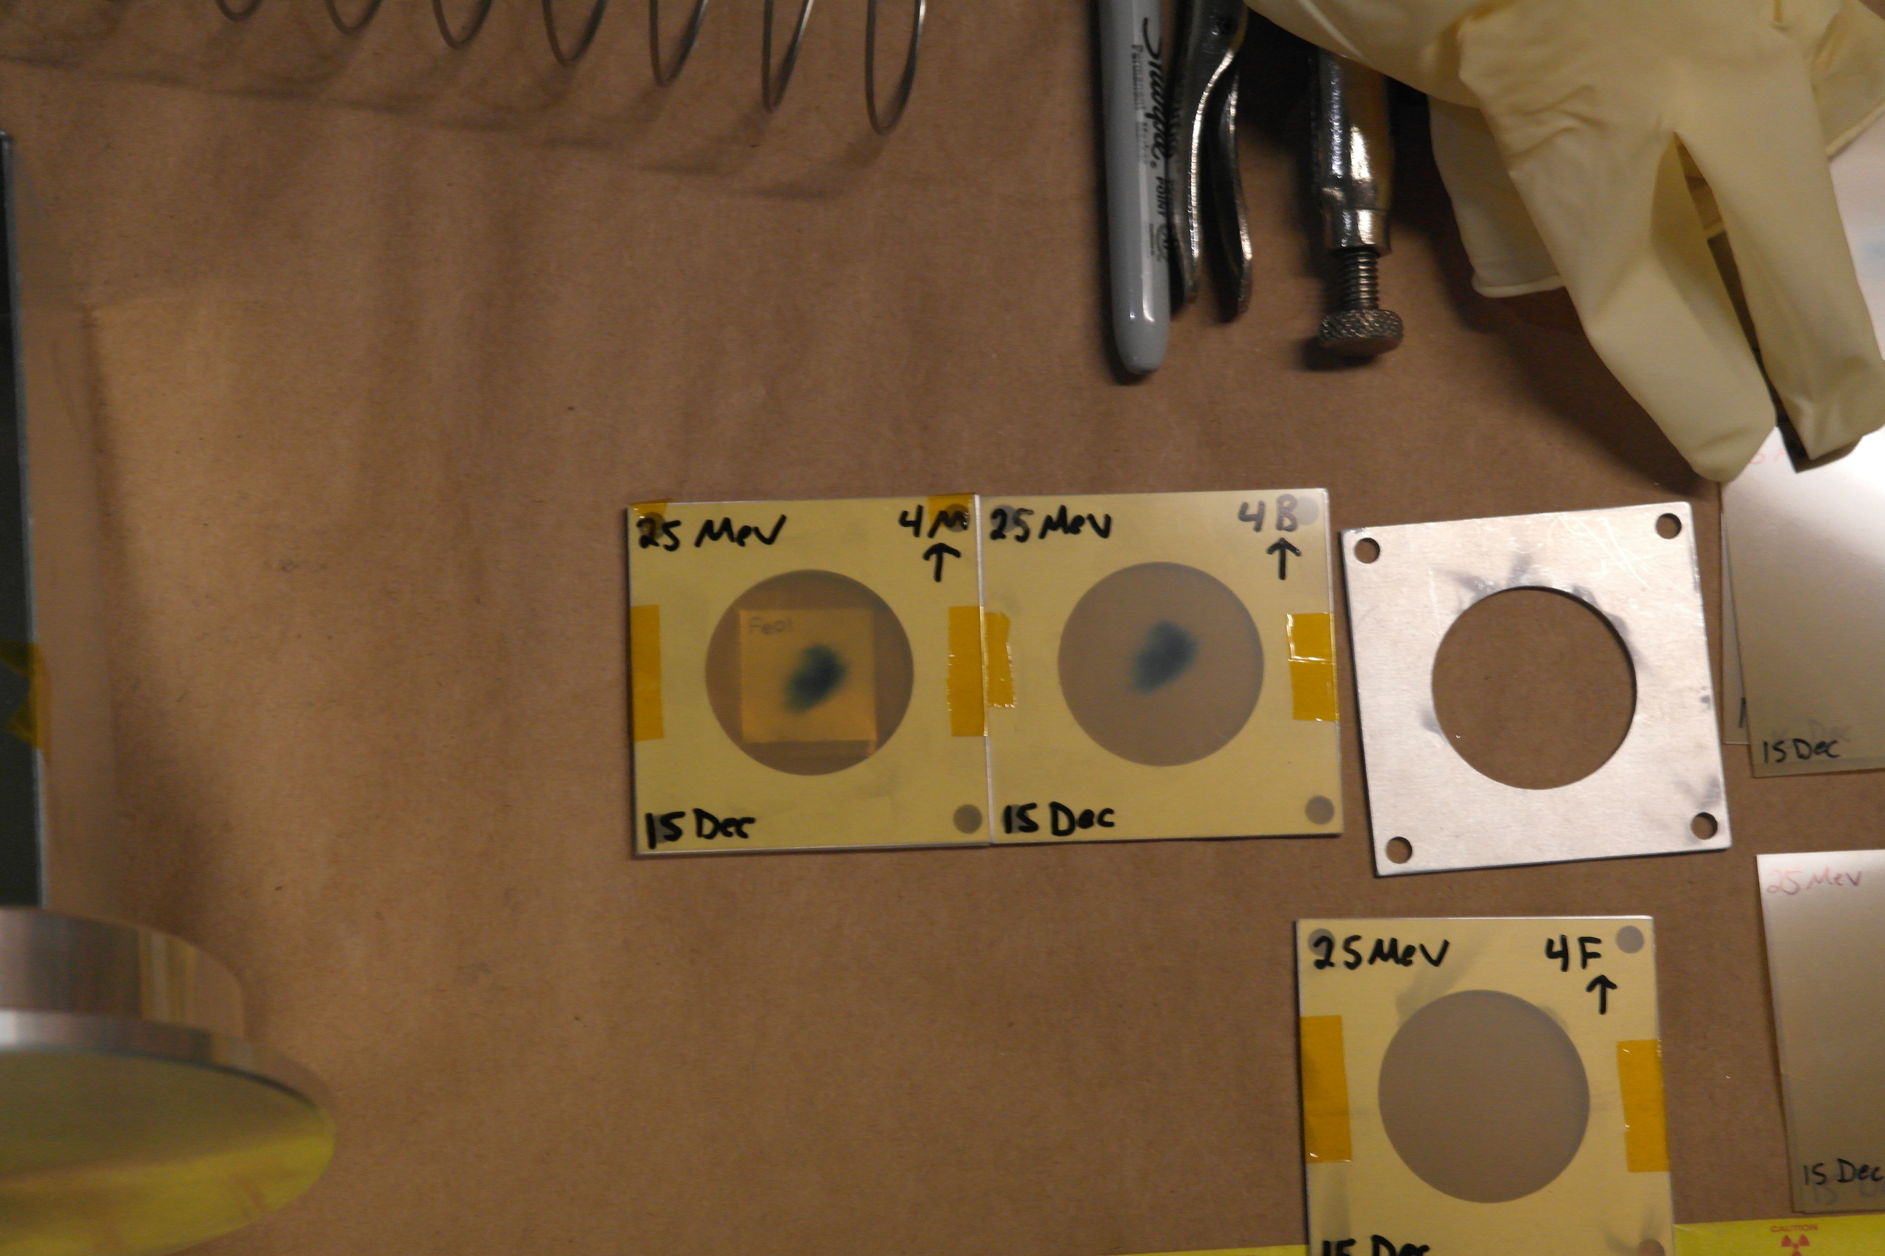
A. Springer
L. Bernstein
2.5 cm
Two overlapping stacks: E_{p}= 55→21 MeV, 25→11 MeV
(120 nA@10 min, 100 nA@20 min)

Slide 44
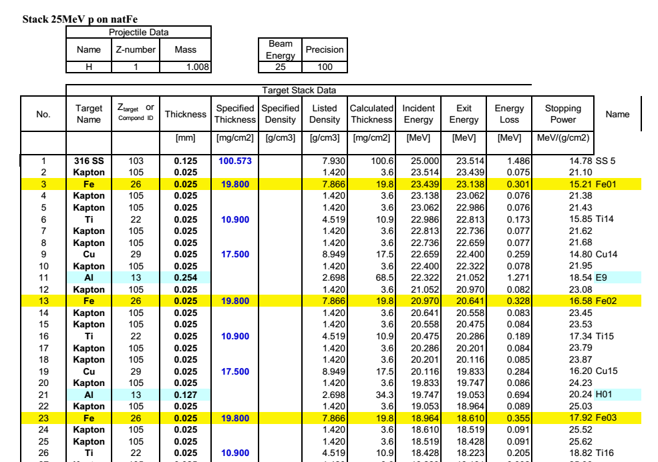
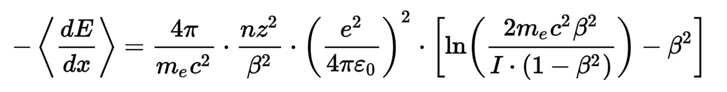
Methodology
Initial stack design planned using analytic Anderson & Ziegler stopping power formalism (SRIM)¹
Contains empirical corrections to Bethe-Bloch for nuclear stopping, low-energy stopping power
[1] J.F. Ziegler,, J. Appl. Phys. 85 (1999) 1249–1272.
Notes:
Beta = v/c
I ~ 10 eV * Z

Slide 45
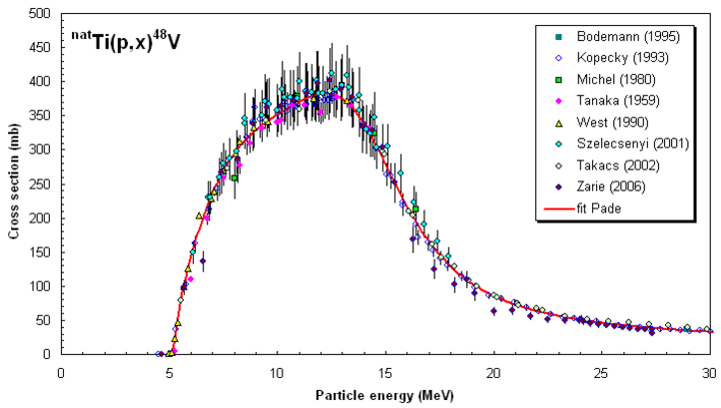
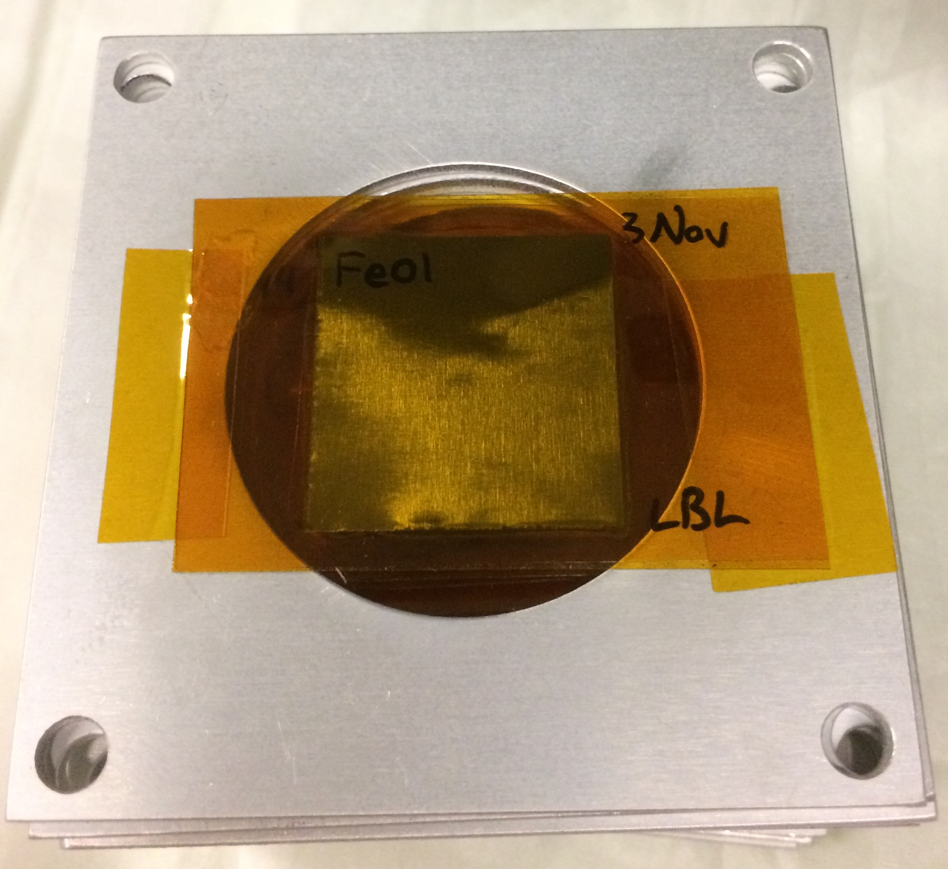
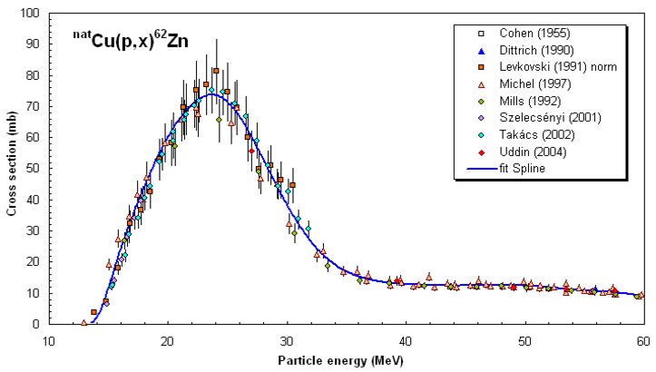
25 μm-thin ^{nat}Fe, ^{nat}Cu, ^{nat}Ti foils in 0.1” Al frames
2.5 cm
Dosimetry: IAEA charged particle beam monitor reactions:
^{nat}Ti(p,x)⁴⁸V
^{nat}Cu(p,x)^{62,63,65}Zn
nds.iaea.org/medical/monitor_reactions.html

Slide 46
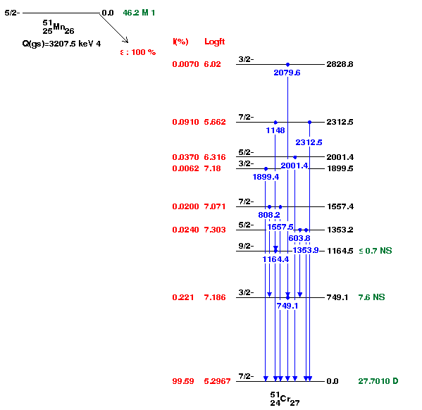
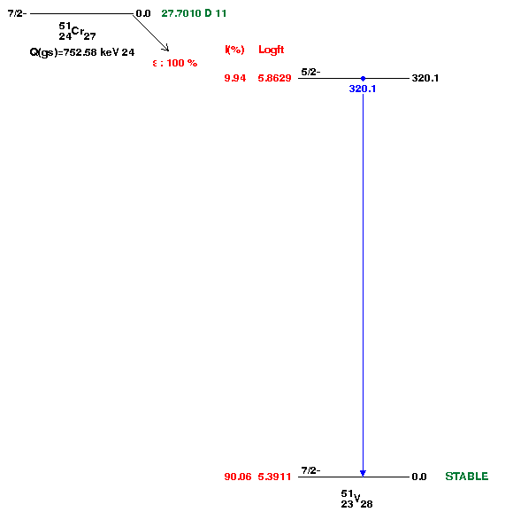
Spectroscopy
ε, t_{1/2}= 27.7 d
^{nat}Fe(p,x)⁵¹Mn → ⁵¹Cr → ⁵¹V
⁵¹Mn decay has no strong gammas, just annihilation 511’s
Production is quantified using the ⁵¹Cr decay 320.1 keV line
ε, t_{1/2}= 46.2 m

Slide 47
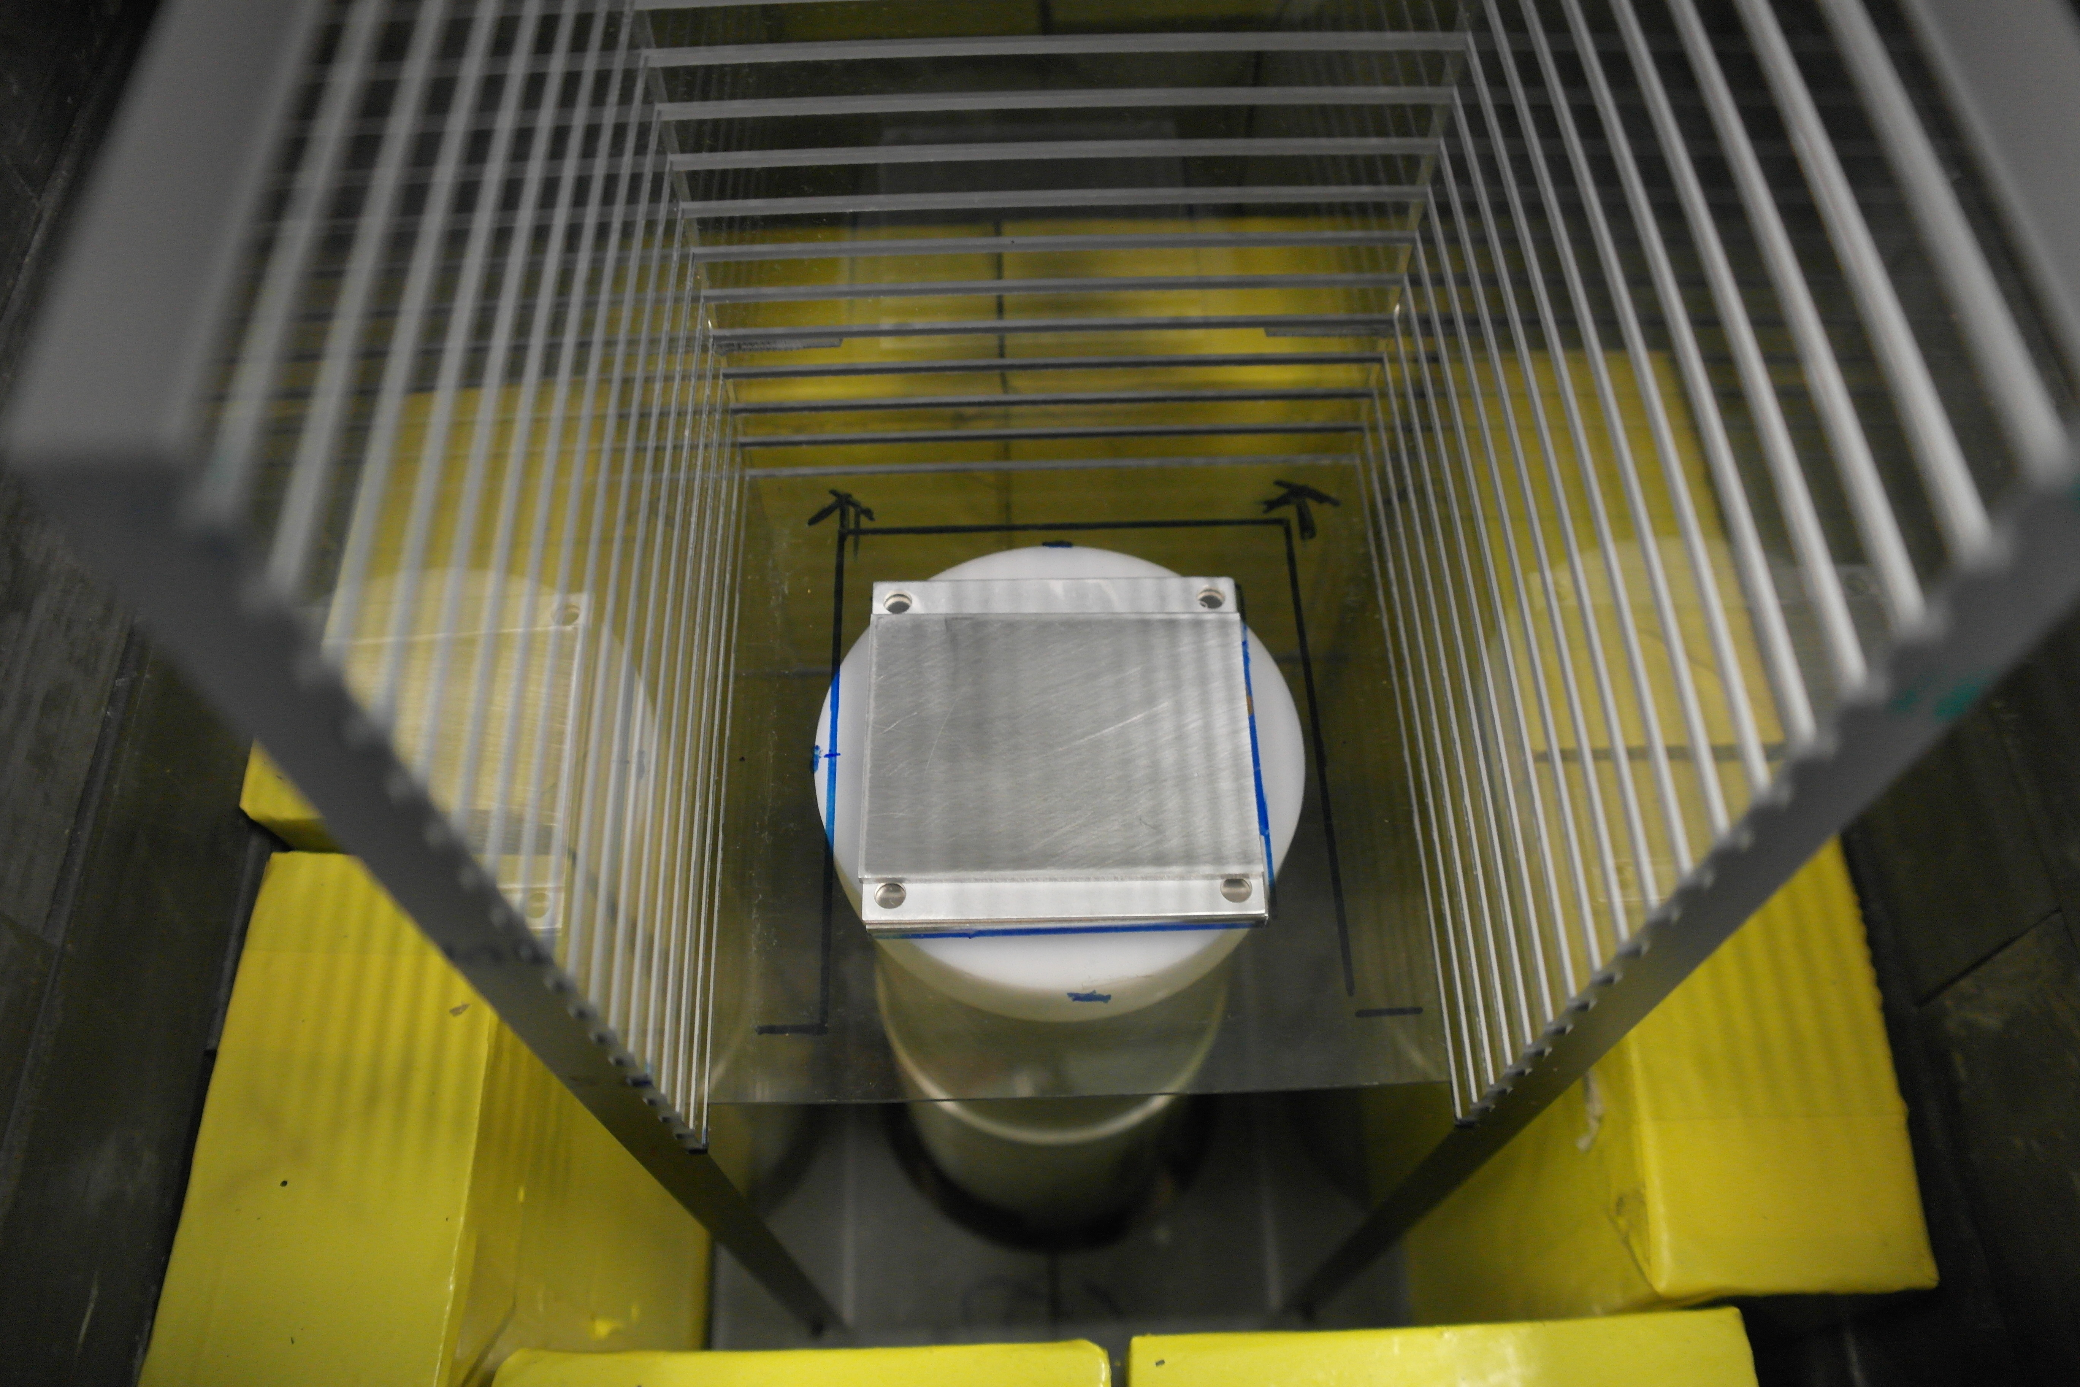

Spectroscopy
⁵¹Mn β’s have max energy of 963.67 keV
NIST ESTAR tables list aluminum CSDA range of 0.4873 g/cm² = 0.18 cm
Notes:
CSDA assumes total stopping power at all points – simply integral of dE/dx * dx

Slide 48
Fe(p,x)
Cu(p,x)
Ti(p,x)

Slide 49
Data Analysis Issues
Why is no activity seen in Ti20 / Cu20?

Slide 50



Notes:
Monitor foils as “canary in the coal mine”

Slide 51
Corrected Energy Assignments
Acrylic Adhesive
Kapton
38 μm @1.18 g/cm³ = 4.48 mg/cm²
25 μm @1.42 g/cm³ = 3.55 mg/cm²
Activation Foil
25 μm = 11 - 23 mg/cm²
Acrylic Adhesive
Kapton
25 μm @1.42 g/cm³ = 3.55 mg/cm²
38 μm @1.18 g/cm³ = 4.48 mg/cm²

Slide 52

Corrected Energy Assignments

Slide 53



Slide 54

LANL sees the same issue…
S. A. Graves, P. A. Ellison, T. E. Barnhart, H. F. Valdovinos, E. R. Birnbaum, F. M. Nortier, R. J. Nickles, and J. W. Engle, Nucl. Instruments Methods Phys. Res. Sect. B Beam Interact. with Mater. Atoms, vol. 386, pp. 44–53, Nov. 2016.

Slide 55
Corrected Energy Assignments
Minimize in 2D:
Effective adhesive areal density (±20%, in 1% steps = 41 trials)
Initial beam energy dispersion (0.5%, 1%, 1.5%, 2% = 4 trials)
164 simulations → Running on UCB Savio HPC
Adhesive should have a much stronger impact than beam dispersion

Slide 56

Corrected Energy Assignments
Goal: Minimize standard deviation of

Slide 57

Preliminary
Expected region for (p,xn)⁵²Mn peak…
Using current from charge integrator
Notes:
Discrepancy possible causes :
Still using current from charge integrator, once energy assignment is finished, monitor foils will provide renormalization to true current
Direct production of 51Cr creates “extra” cross section
Low peak is 54Fe(p,x), high peak is 56Fe(p,x)

Slide 58



Slide 59
Preliminary

Slide 60



Spin Distribution
Constant Temperature + Fermi Gas:
In TALYS, R_{spin-cut} is used as a tunable scaling parameter for σ²
[1] T. von Egidy and D. Bucurescu, Phys. Rev. C, vol. 80, no. 5, p. 54310, Nov. 2009.
[1] S. M. Qaim, Nucl. Med. Biol., vol. 44, pp. 31–49, 2016.
Notes:
Spin cut-off paramater (sigma) represents the J distribution width of the level density – tuning parameter

Slide 61
Preliminary
Results consistent with R≈1 at high energy.
At low energy, results are ambiguous due to energy straggling.

Slide 62
Spin Distribution Application
Through its impact on nuclear level densities, the spin cut-off parameter has a strong impact on the favoring of higher-spin isomers in charged particle-induced reactions – a “tuning parameter” for isomer-to-ground state branching ratio
Reaction physics codes can be used to model (σ_{m}/σ_{g}) when experimental data is unavailable
Case study: ¹⁷⁷Lu
^{177g}Lu (t_{1/2} = 6.7 d) – emerging β⁻ therapy agent
^{177m}Lu (t_{1/2} = 160 d) – contributes extra dose to patient, without therapeutic or diagnostic benefit
Improved spin distribution measurements can improve modeling to guide production studies

Slide 63
Stacked-target Charged Particle Excitation Functions
___________________________
^{Moderate Energy – LANL}

Slide 64
Measurements @ LANL – Nb(p,x)
^{nat}Nb(p,4n)⁹⁰Mo is a high-priority objective as a new proton beam dosimetry standard for E_{p} ≈ 50 – 100 MeV
Other emerging radionuclides: ^{82m}Rb, ⁸⁶Y, ⁸⁹Zr, ⁹⁰Nb
Z
ε+β⁺
IT |  |  |  |  |  |  | ⁹³Nb
 |  |  |  |  |  |  |  | β⁻
^{100 MeV} ^{p+}
N

Slide 65
Measurements @ LANL – Nb(p,x)
^{nat}Nb(p,4n)⁹⁰Mo is a high-priority objective as a new proton beam dosimetry standard for E_{p} ≈ 50 – 100 MeV
Other emerging radionuclides: ^{82m}Rb, ⁸⁶Y, ⁸⁹Zr, ⁹⁰Nb
Z
ε+β⁺ |  |  |  |  |  |  | ⁹⁴Mo
IT |  |  |  |  |  |  | ⁹³Nb
 |  |  |  |  |  |  |  | β⁻
^{100 MeV} ^{p+}
N

Slide 66
Measurements @ LANL – Nb(p,x)
^{nat}Nb(p,4n)⁹⁰Mo is a high-priority objective as a new proton beam dosimetry standard for E_{p} ≈ 50 – 100 MeV
Other emerging radionuclides: ^{82m}Rb, ⁸⁶Y, ⁸⁹Zr, ⁹⁰Nb
Z
ε+β⁺ |  |  | ⁹⁰Mo |  |  | ^{93m}Mo | ⁹⁴Mo
IT |  |  | ^{89m}Nb ⁸⁹Nb | ⁹⁰Nb | ^{91m}Nb | ^{92m}Nb | ⁹³Nb
 | ⁸⁶Zr |  | ⁸⁸Zr | ⁸⁹Zr
 |  | ⁸⁶Y | ^{87m}Y ⁸⁷Y | ⁸⁸Y
⁸³Sr |  | ^{85m}Sr
^{82m}Rb |  |  |  |  |  |  |  | β⁻
^{100 MeV} ^{p+}
N

Slide 67

Measurements @ LANL – Nb(p,x)
IPF
Proton Injectors
201.25 MHz Drift Tube Linac
p+
805 MHz Side-Coupled Cavity Linac
To research centers
p+
p-
800 m
p-
750 keV
100 MeV
800 MeV
h+

Slide 68




Measurements @ LANL – Nb(p,x)
LBNL: 5 – 55 MeV / A, LANL: 45 – 100 MeV p⁺
Complementary measurements explore reaction dynamics in different energy regimes, overlap region of 45-55 MeV builds confidence and consistency in results.
M. Nortier
^{100 nA @ 3 hr}
^{100 MeV p+}

Slide 69
Measurements @ LANL – Nb(p,x)

Slide 70
Measurements @ LANL – Nb(p,x)
1894 unique peaks across 107 spectra

Slide 71

Measurements @ LANL – Nb(p,x)

Slide 72
S. A. Graves, P. A. Ellison, T. E. Barnhart, H. F. Valdovinos, E. R. Birnbaum, F. M. Nortier, R. J. Nickles, and J. W. Engle, Nucl. Instruments Methods Phys. Res. Sect. B Beam Interact. with Mater. Atoms, vol. 386, pp. 44–53, Nov. 2016.

Slide 73

Measurements @ LANL – Nb(p,x)
Preliminary

Slide 74
Measurements @ LANL – Nb(p,x)
Preliminary

Slide 75
Summary
Demonstrated ability to measure excitation functions for emerging medical radionuclides through 3 different production paradigms
Provides first / vastly improved production measurements for each of the isotopes listed here
Thin-target measurements in this work provide an ideal jumping-off point to begin thick-target yields for commercial application, as well as radiochemical workup

Slide 76
Path Forward
^{nat}Fe(p,x)
Complete minimization of inter-reaction fluences for final energy assignment and stack fluence
Identify and quantify additional activities produced
Nb(p,x)
Complete minimization of inter-reaction fluences for final energy assignment and stack fluence
All activities are quantified – energy assignments are all that remain to normalize into absolute cross sections
Finish spin distribution analysis for isomers produced
08 September - ^{nat}La(p,6n)¹³⁴Ce @ 88
Positron analogue for ²²⁵Ac development

Slide 77

Thank you!

Slide 78
^{Extra Slides}
___________________________

Slide 79





Cross-Section Systematics

Slide 80

Neutron Utilization
Theoretical saturation activities are currently estimated at 1.5 kBq of ⁶⁴Cu, 0.11 kBq of ⁴⁷Sc
Measured production rates were 453.8 Bq of ⁶⁴Cu, 31.6 Bq of ⁴⁷Sc
Implies η ≈ 29.9%
Path to upgrades:
Thicker activation target (1 cm) → factor 10
Increased current, run second ion source → factor 60
Switch to DT operation → factor 80
Higher (n,p) cross section at DT energies → factor 3
Estimated saturation activities of 6 mCi ⁶⁴Cu, 0.5 mCi ⁴⁷Sc

Slide 81
Decay Schemes

Slide 82



Slide 83



Slide 84


Slide 85


Slide 86


Slide 88


Slide 89
Granddaughter Decay Spectroscopy

Slide 90


Slide 91


Slide 92


Slide 93

S. A. Graves, P. A. Ellison, T. E. Barnhart, H. F. Valdovinos, E. R. Birnbaum, F. M. Nortier, R. J. Nickles, and J. W. Engle, Nucl. Instruments Methods Phys. Res. Sect. B Beam Interact. with Mater. Atoms, vol. 386, pp. 44–53, Nov. 2016.

